Slide 1


Mini Activation Force 10.
23.03.2016

Slide 2
FORCE 10
WeChat Activation
China
中国地区微信互动

Slide 3
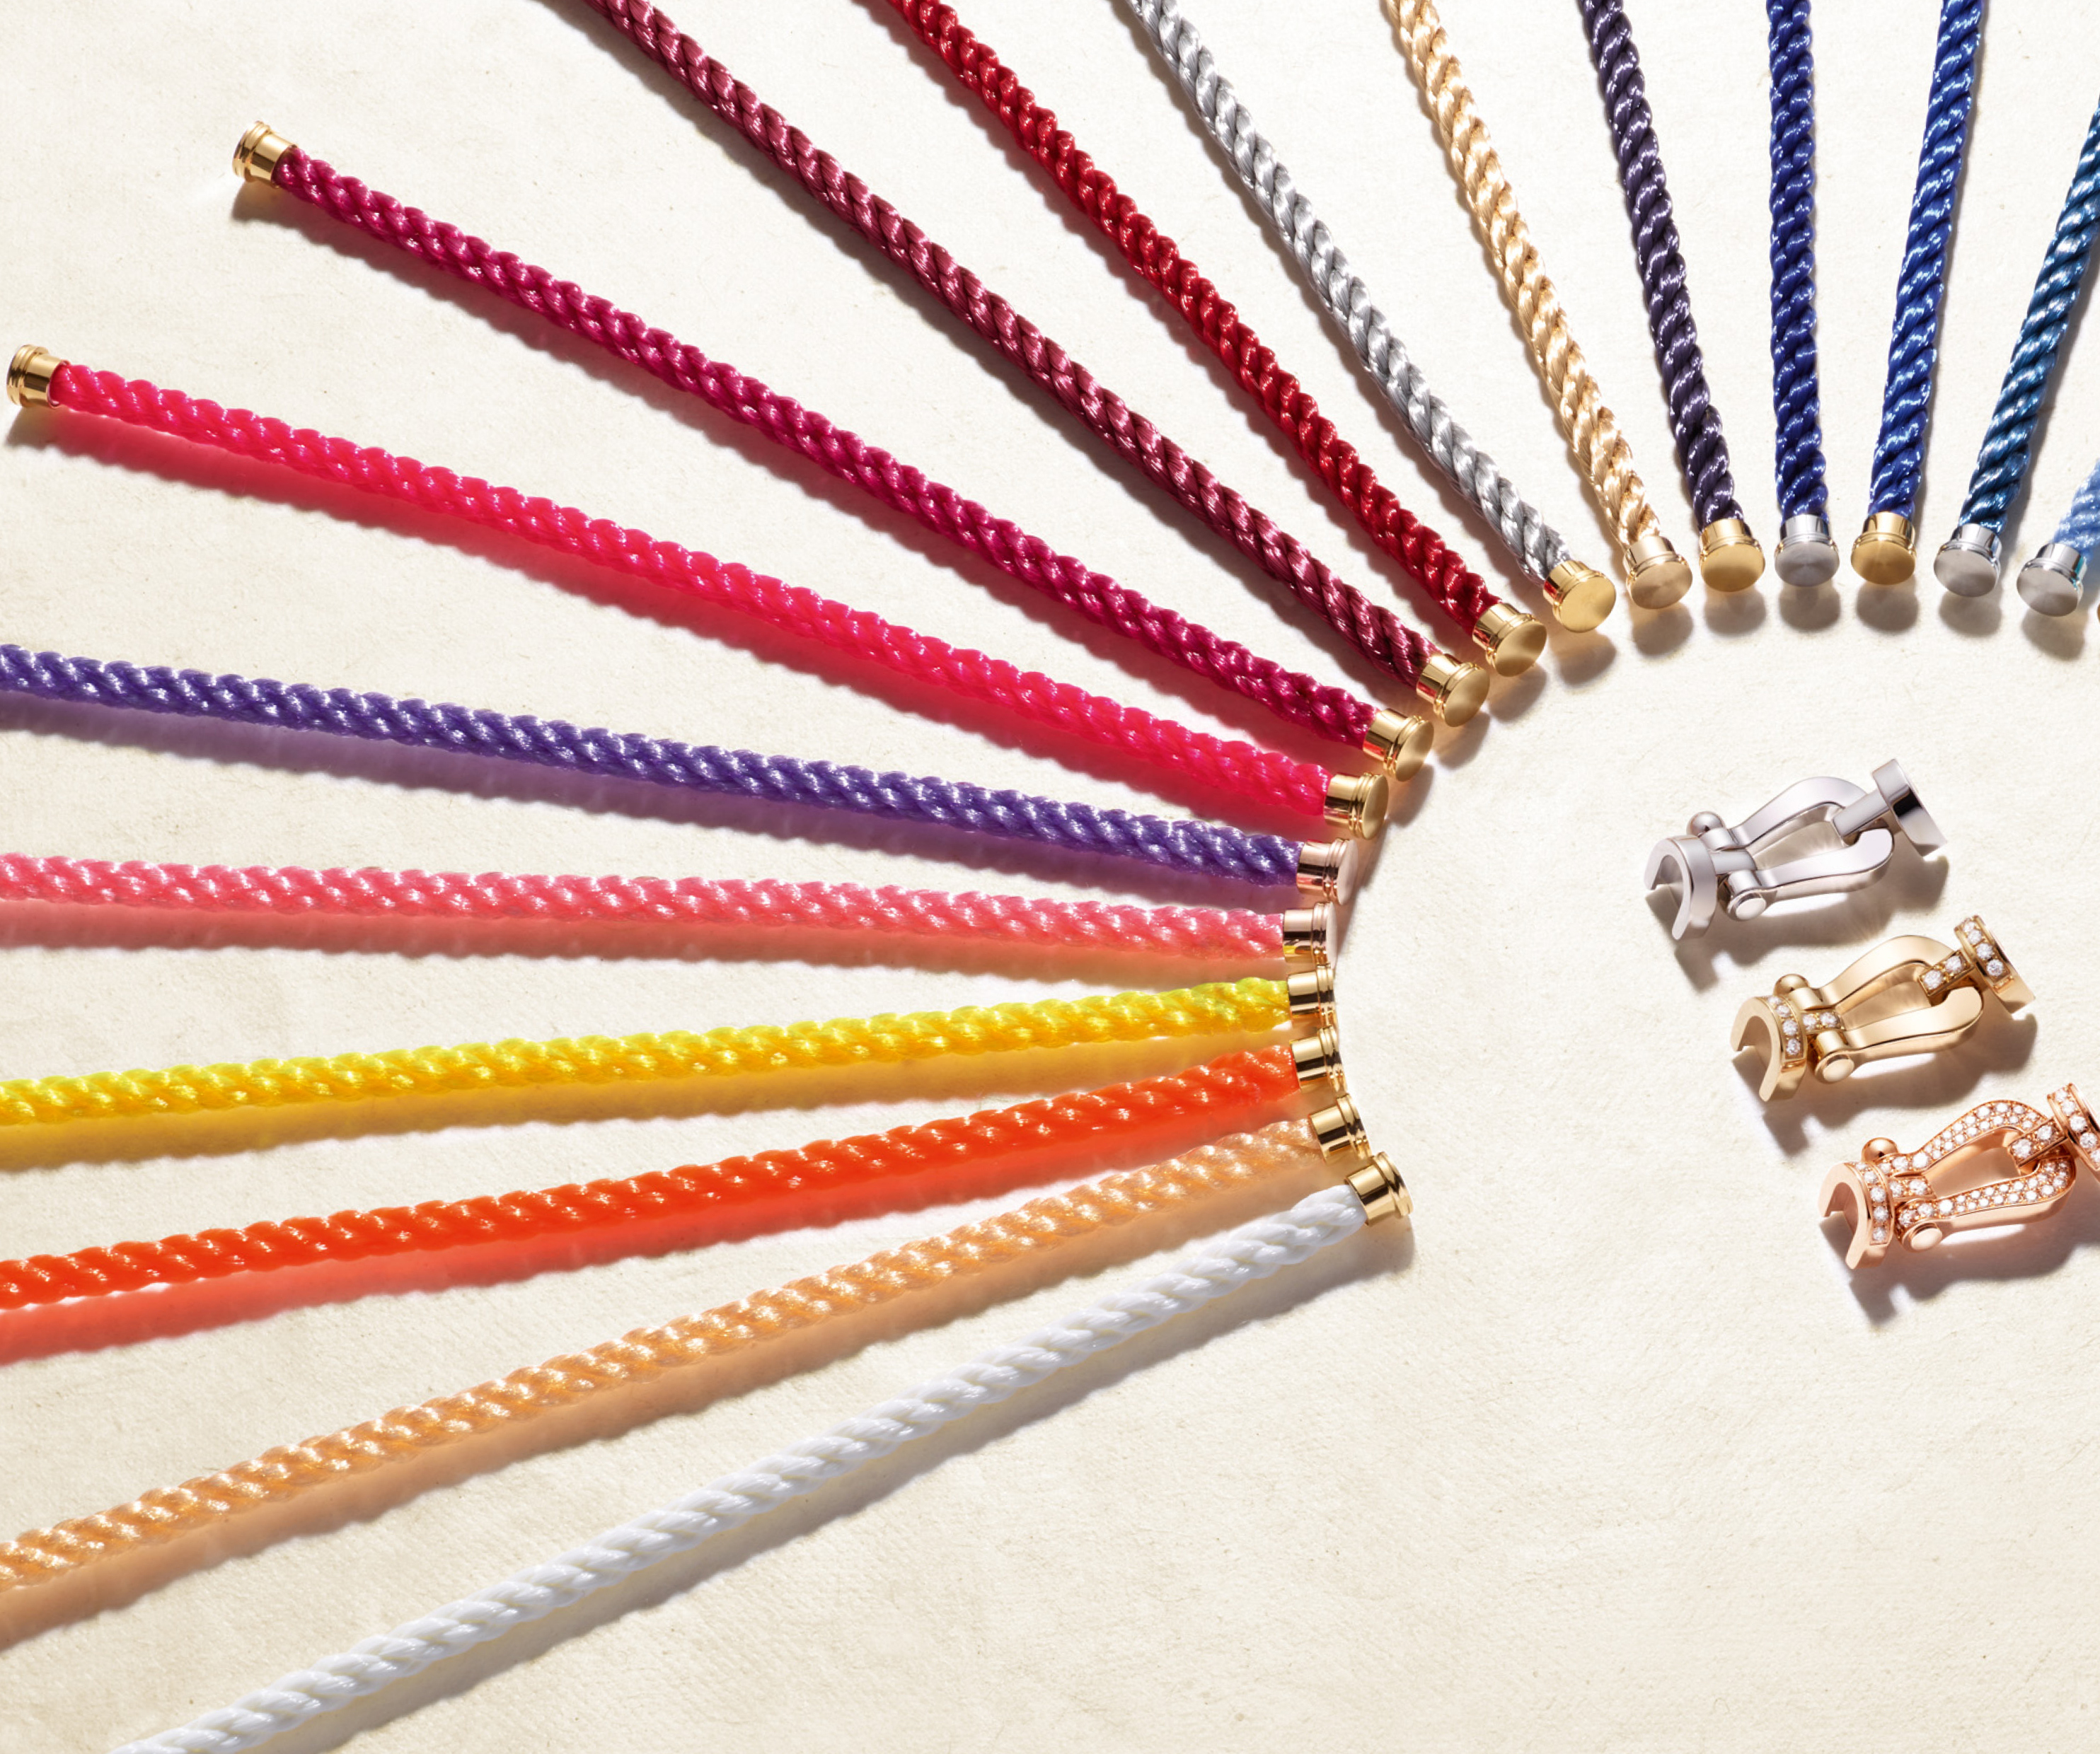
ORIGINE
For the launch of our WeChat account, we wanted an operation that emphasizes the main characteristic of the iconic collection of the brand: the multiplicity of combinations.
The opportunity to fund the account with examples of associations and to know the product more through a simple activation, efficient and colorful!
为了启动我们的微信账号，我们希望启动一项能够显示我们这次庆典所要表达主题的活动.
这是一次能够通过各种范例活跃我们的账户，同时通过这一次简单、有效、色彩斑斓的活动，让尽可能多的大众认识我们

Slide 4
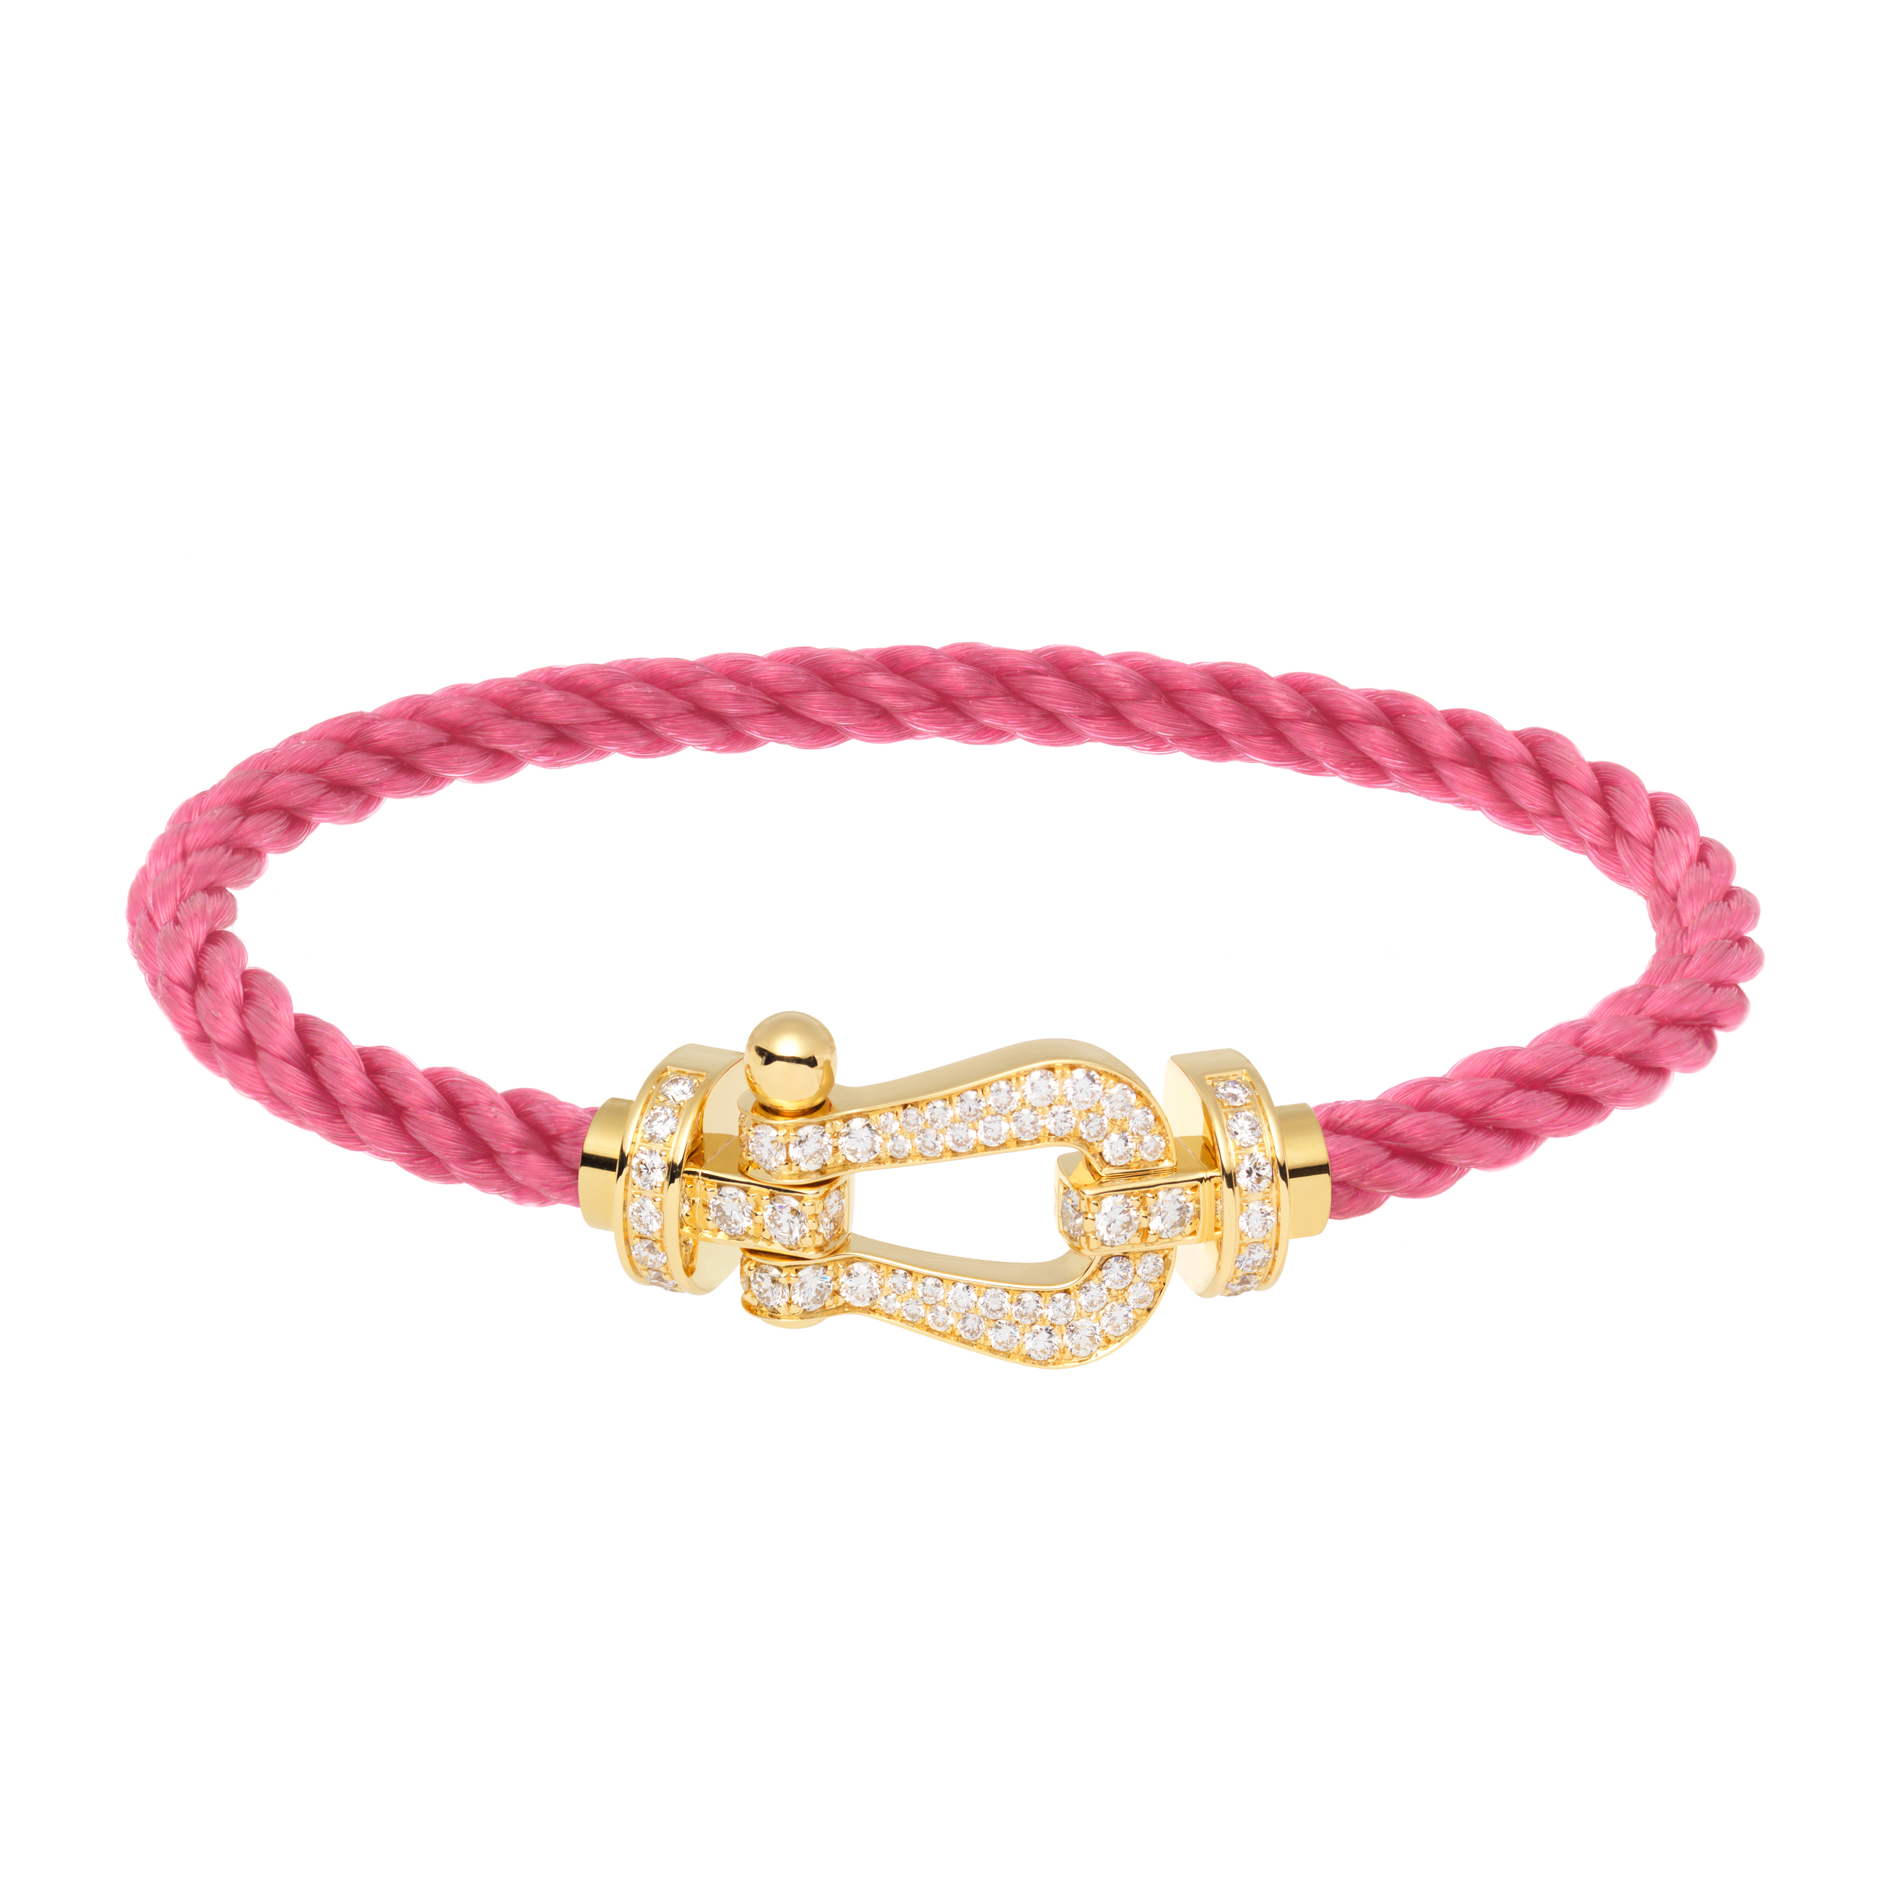
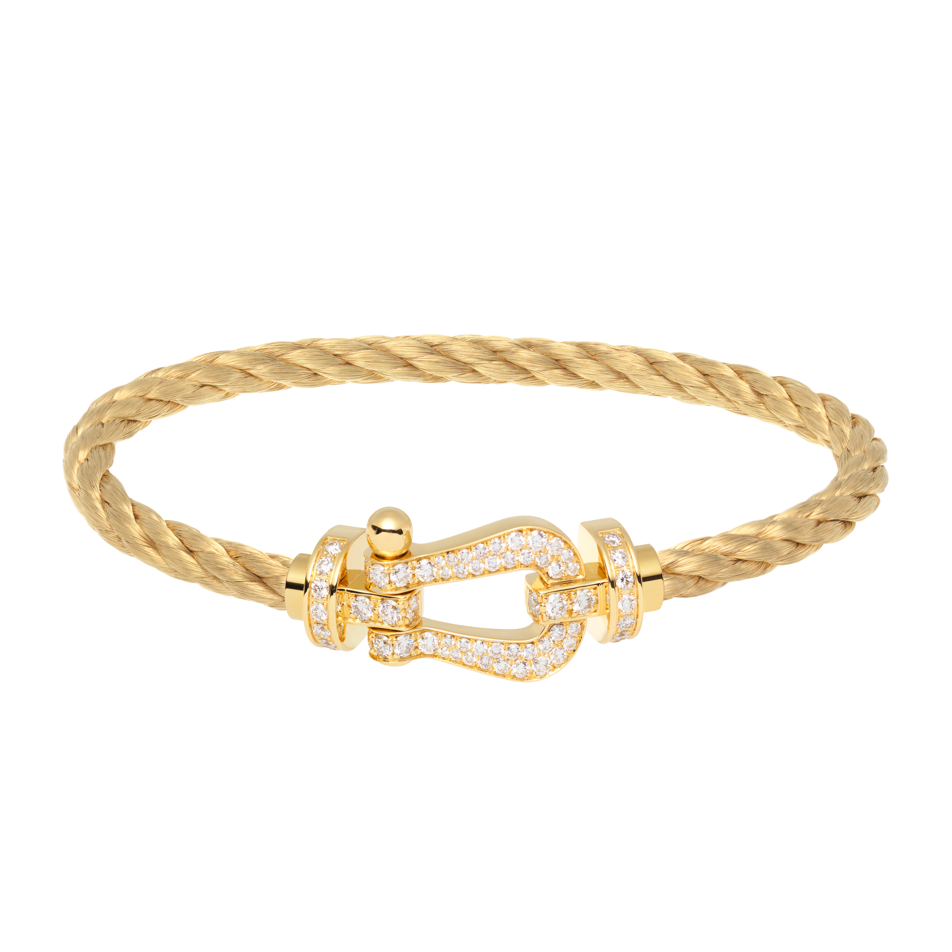
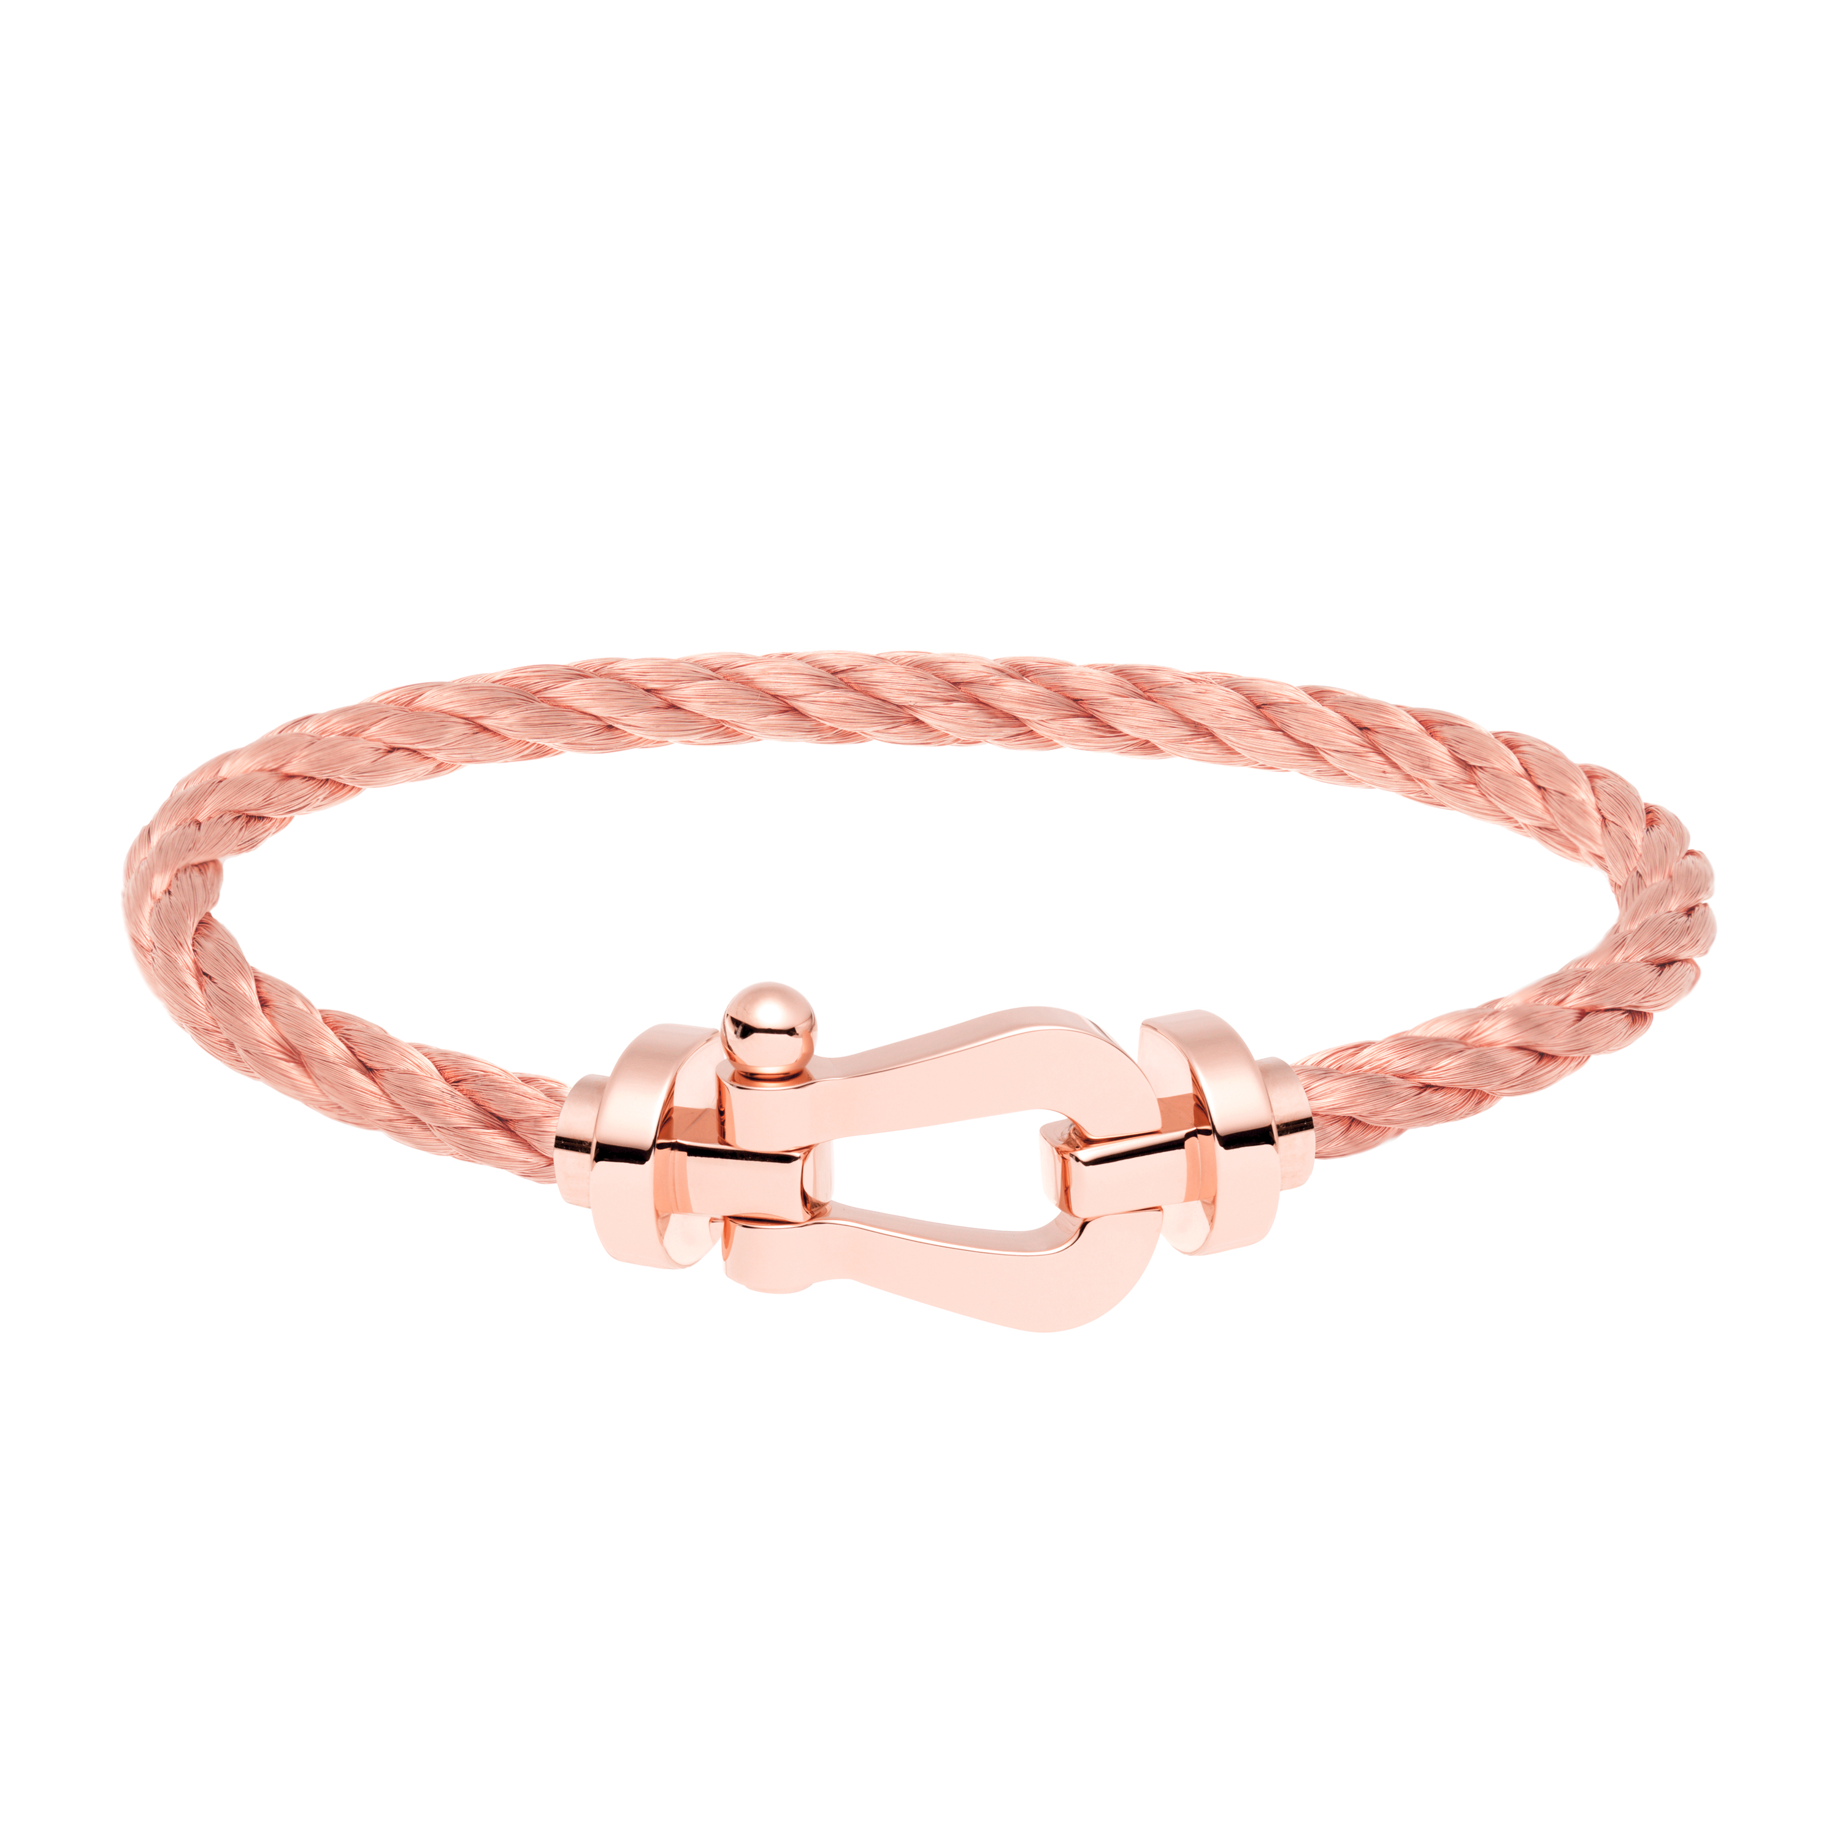
« The Perfect Match » by FRED
Fred的完美匹配
WeChat allow users to realize the possibilities of customizing the Force 10 by using a mini-application to create a bracelet that resembles them.
Via a very intuitive interface, they can change to shackle or cable with a gesture of thumb, bringing with each change some elements of the French Riviera corresponding to the combination created.
让微信用户能够通过迷你应用创建与他们个性相似的Force 10所能展现的各种个性表现.
通过一个直观的界面,他们可以通过手势改变卸扣或缆绳,每一个组合的改变都带着一个南法风情。

Slide 5
GLOBAL MECHANISM
整体机制
A game of 1 week offering mobile users the possibility to win their bracelet Force 10 personalized via different combinations (shackles and cables).
To increase his chances, mobile users will have the opportunity to register once a day. One person will be drawn and will win his custom bracelet in the nearest store FRED.
通过一个星期的游戏 ，让手机使用者可以尝试通过各种组合(卸扣和绳)来赢得他们的FORCE 10手镯
为了增加他们的机会，用户可以每天玩一次。每个人都可参与抽签获得他们的个性手镯，可以到离他们最近的FRED专卖店领取定制的手镯
China adapation: According to Chinese law, we need to add in voting/liking mechanism to give away gift more than 5000 worth of value.
Also, to make it more interesting, maybe we can add a step: “name your lucky bracelet” after the creation is done, the person who wins can also get this bracelet engraved.
中国区的机制：依据中国法律政策，需要加入投票或点赞机制才可以giveaway价值超过五千的礼品
还有，让机制更有趣些，可以加入“命名你自己的幸运手镯”环节，赢家可以获得铭刻名字的手镯。

Slide 6
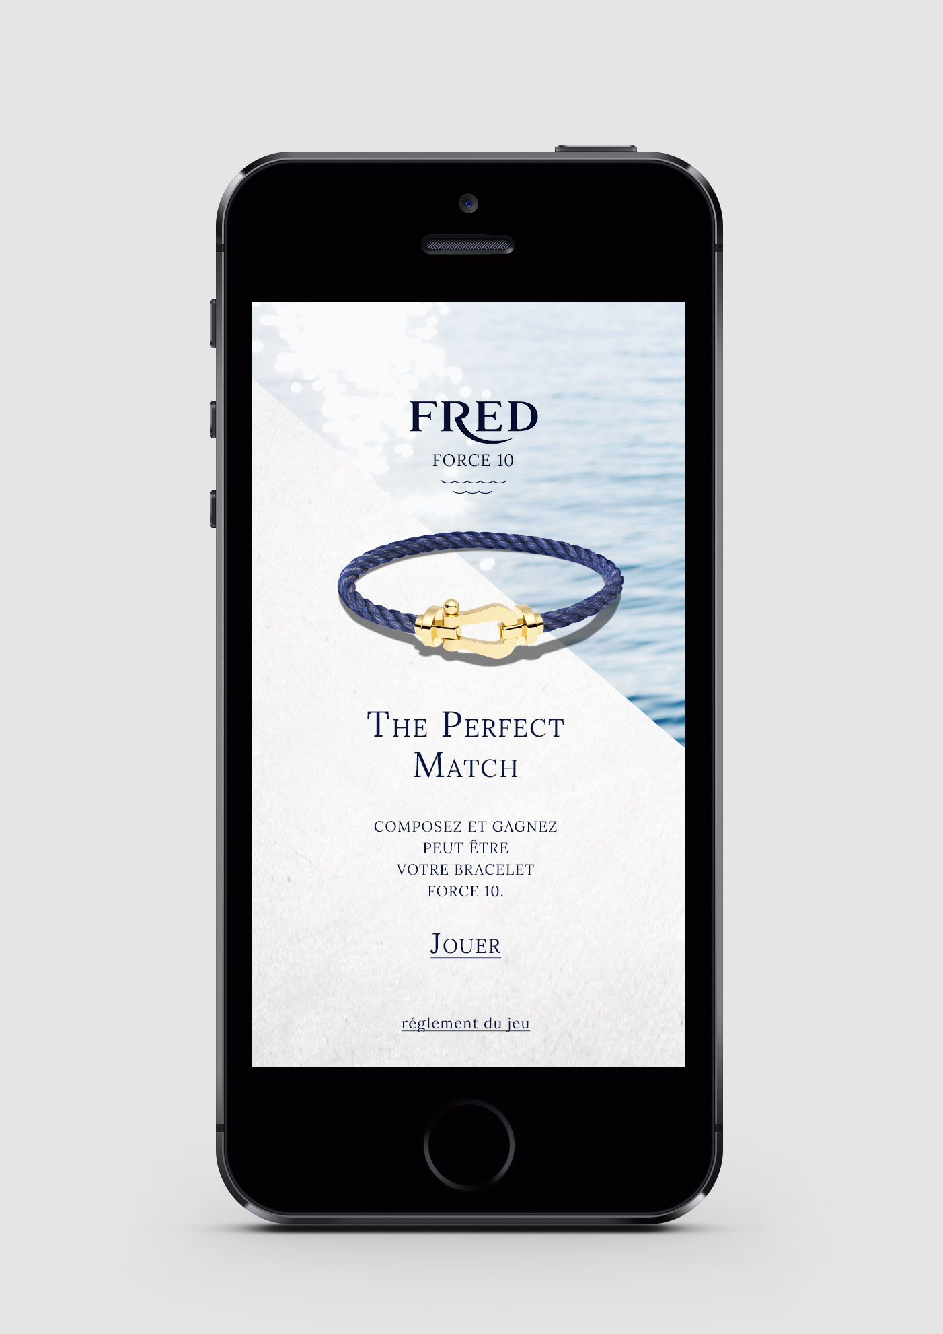
MECHANISM 机制
The first 3 pages set the tone, explains the concept and invites participation
前面3页奠定基调，解释活动理念并邀请用户

Slide 7
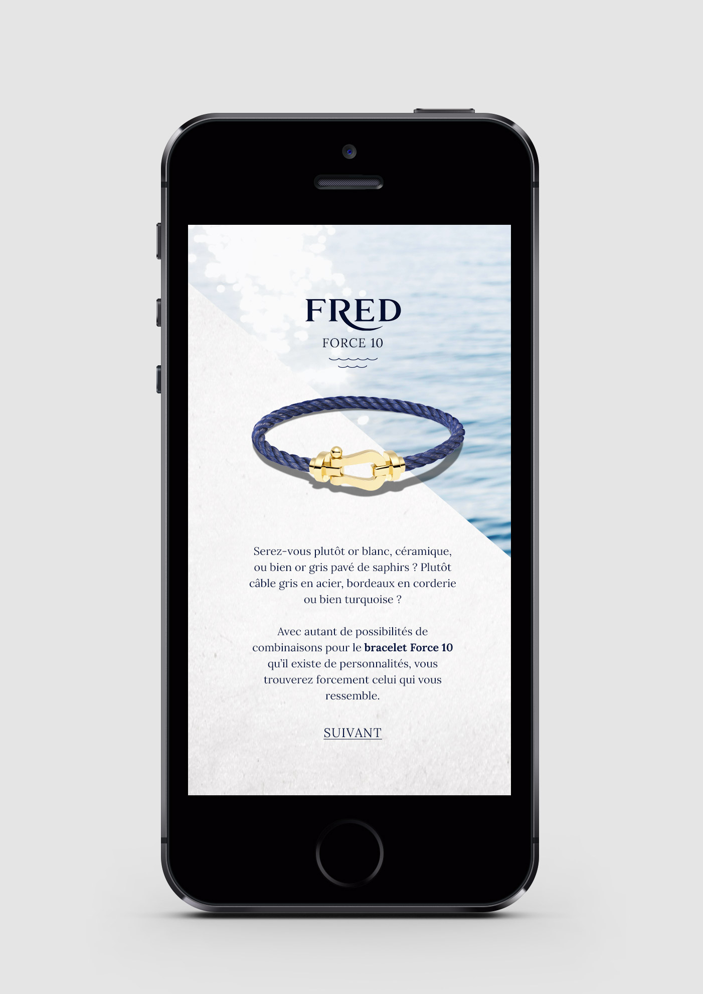
MECHANISM
2. The first 3 pages set the tone, explains the concept and invites participation
前面3页奠定基调，解释活动理念并邀请用户

Slide 8
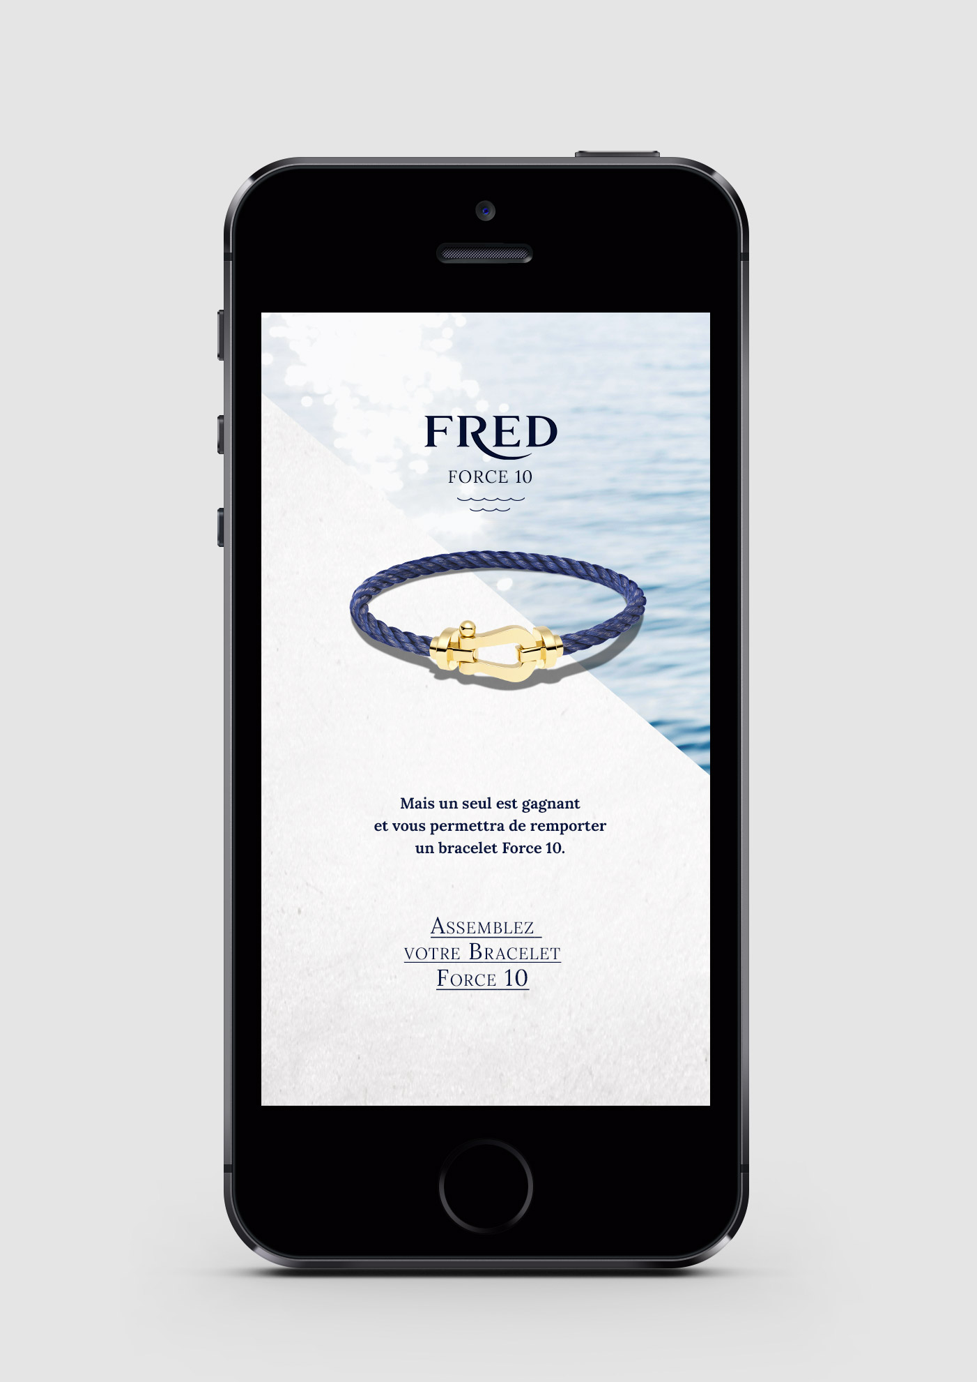
MECHANISM
3. The first 3 pages set the tone, explains the concept and invites participation
前面3页奠定基调，解释活动理念并邀请用户

Slide 9
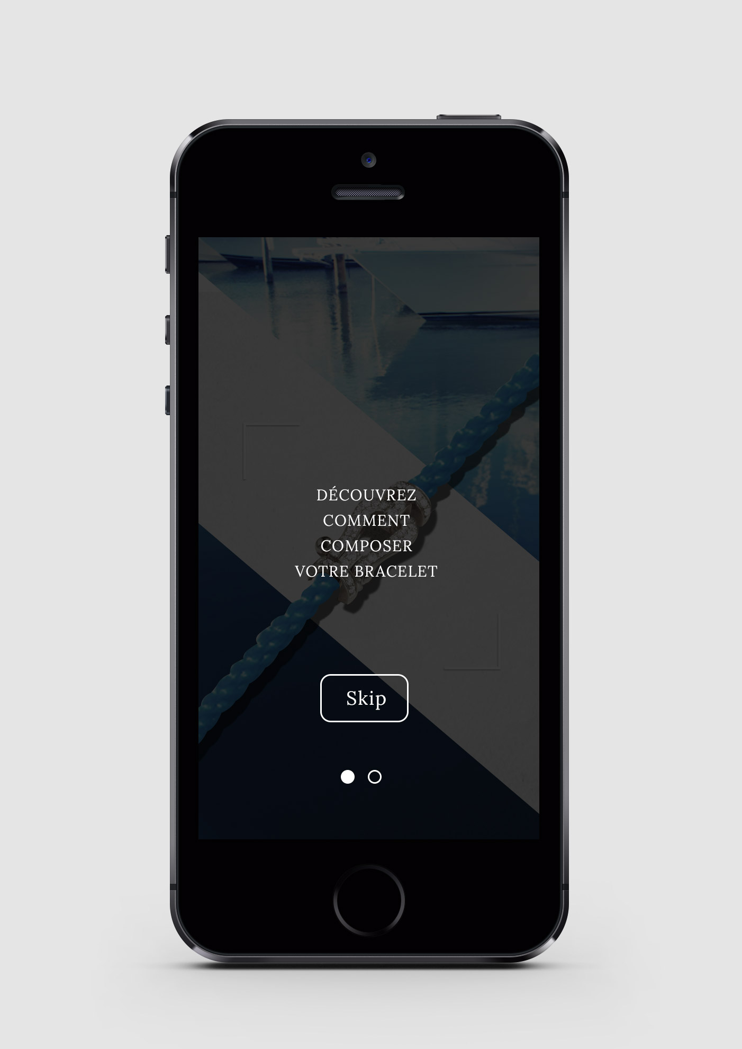
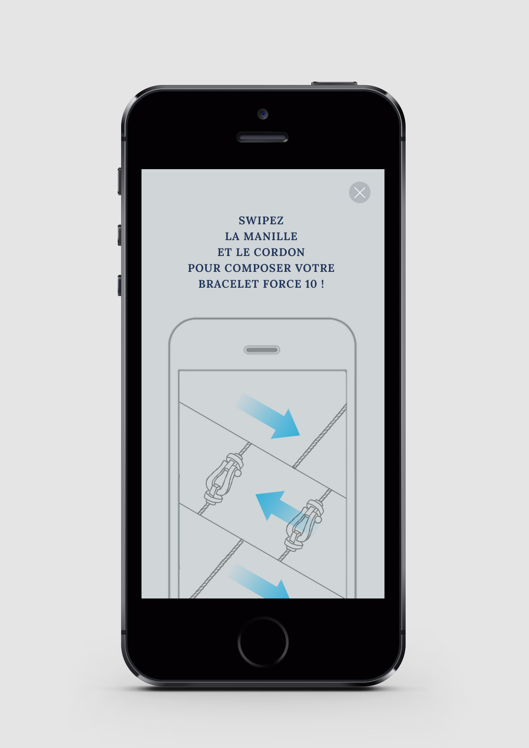
MECHANISM
4. A tutorial explains how to create his bracelet easily by swiping left to change shackle and right to change the color of the cable.
第四页解释如何能非常简单的创造他们自己的手链，向左滑动可以改变卸扣，向右可以改变手镯线颜色

Slide 10
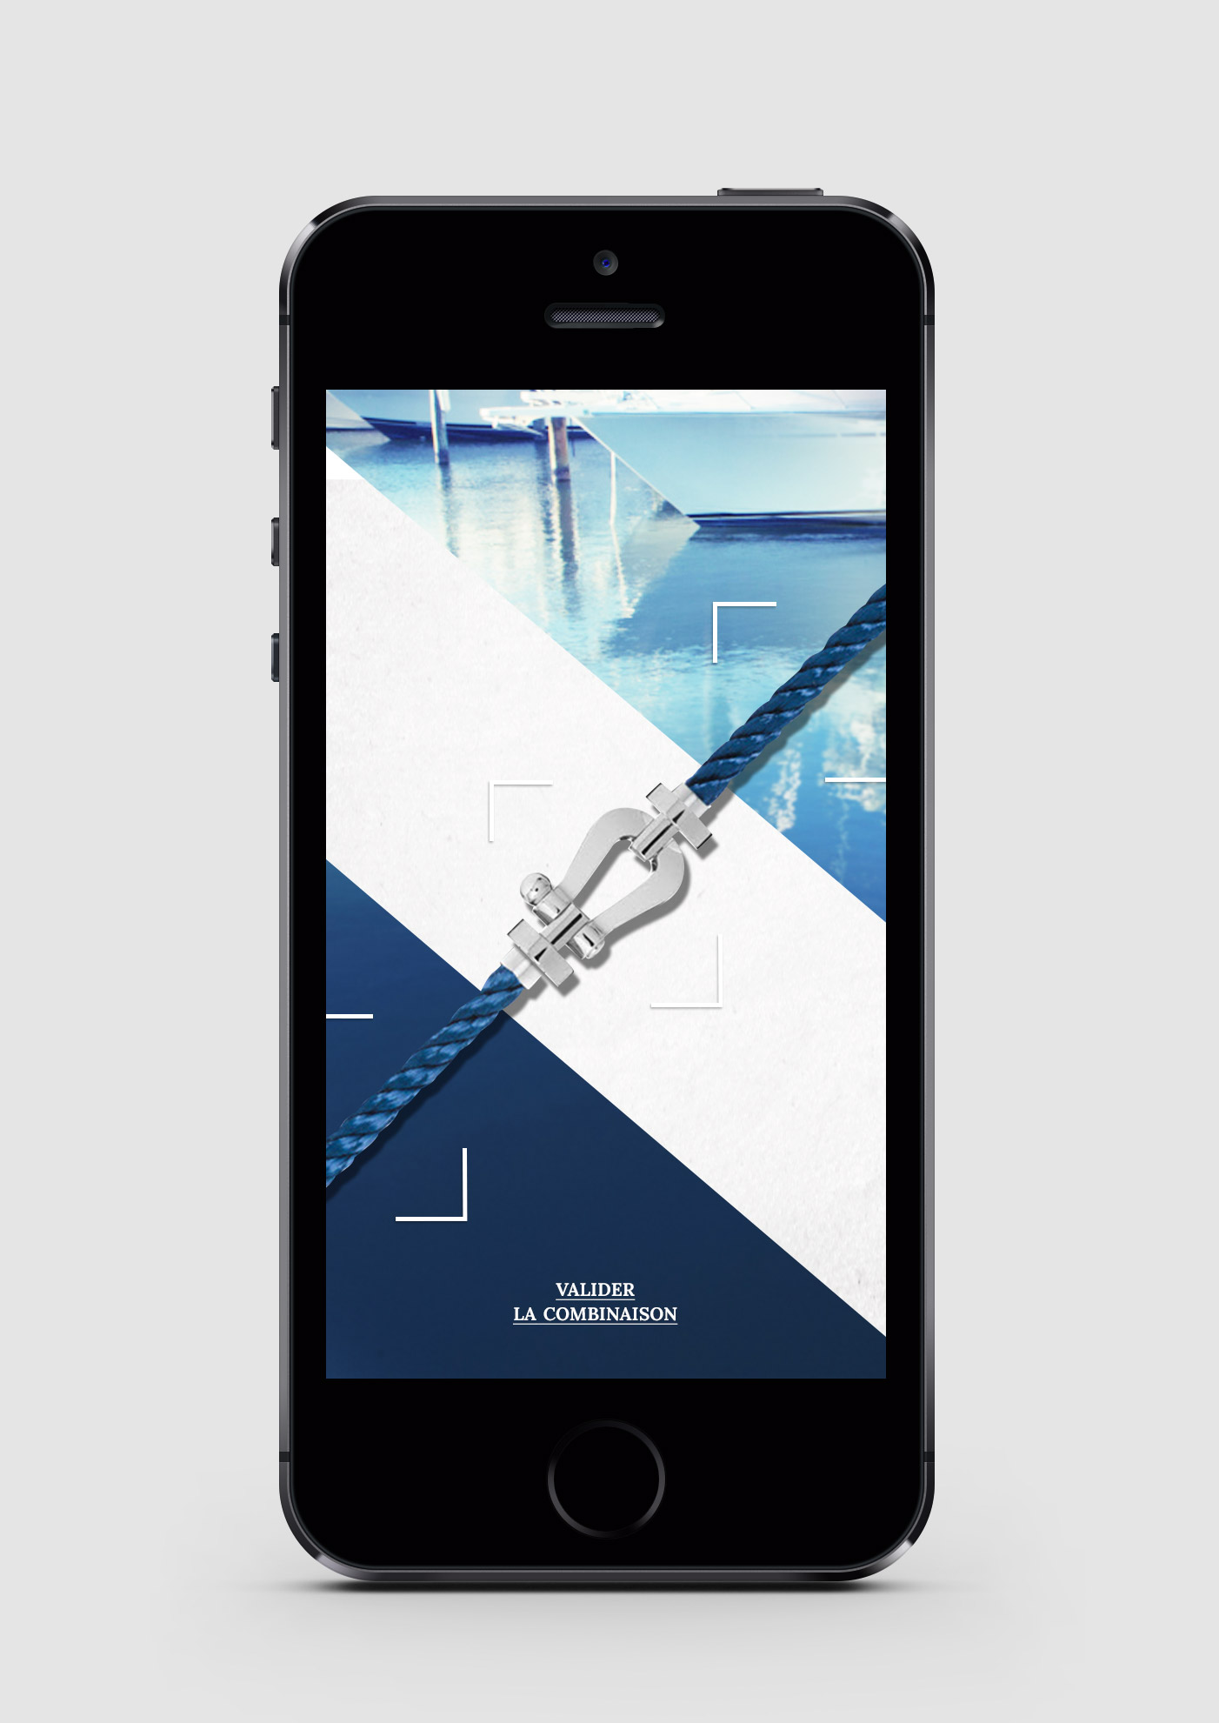
MECHANISM
5. Then we access the interface. We can start to create the Force 10 who looks like us.
接下来进入界面，我们可以开始创造和我们自己相似的Force10

Slide 11
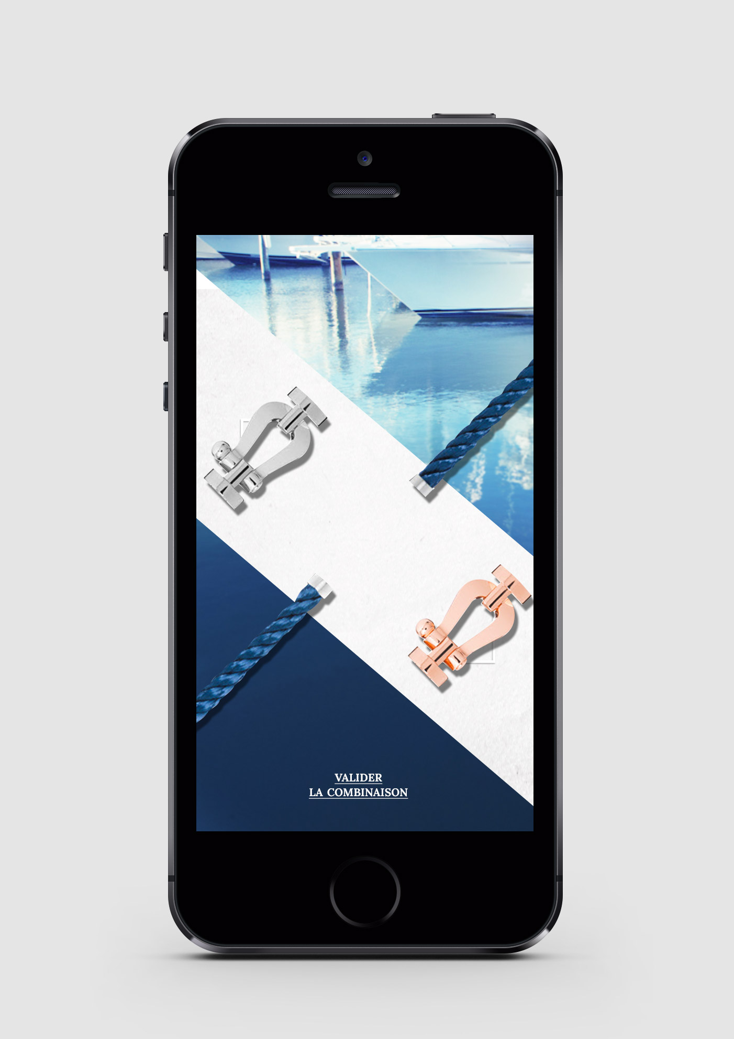
MECHANISM
6. We scroll shackles and cables to provide all possible combinations..
我们滚动各种卸扣和链条的组合，以创造各种可能的结合

Slide 12
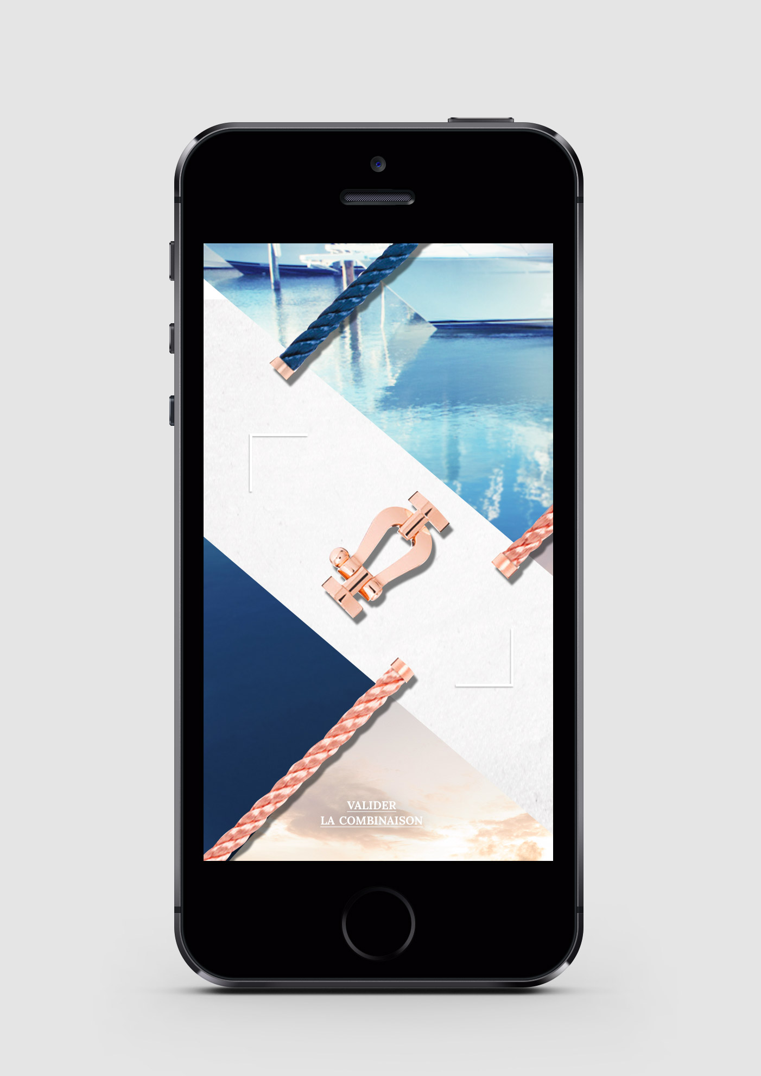
MECHANISM
7. We scroll shackles and cables to provide all possible combinations..
我们滚动各种卸扣和链条的组合，以创造各种可能的结合

Slide 13
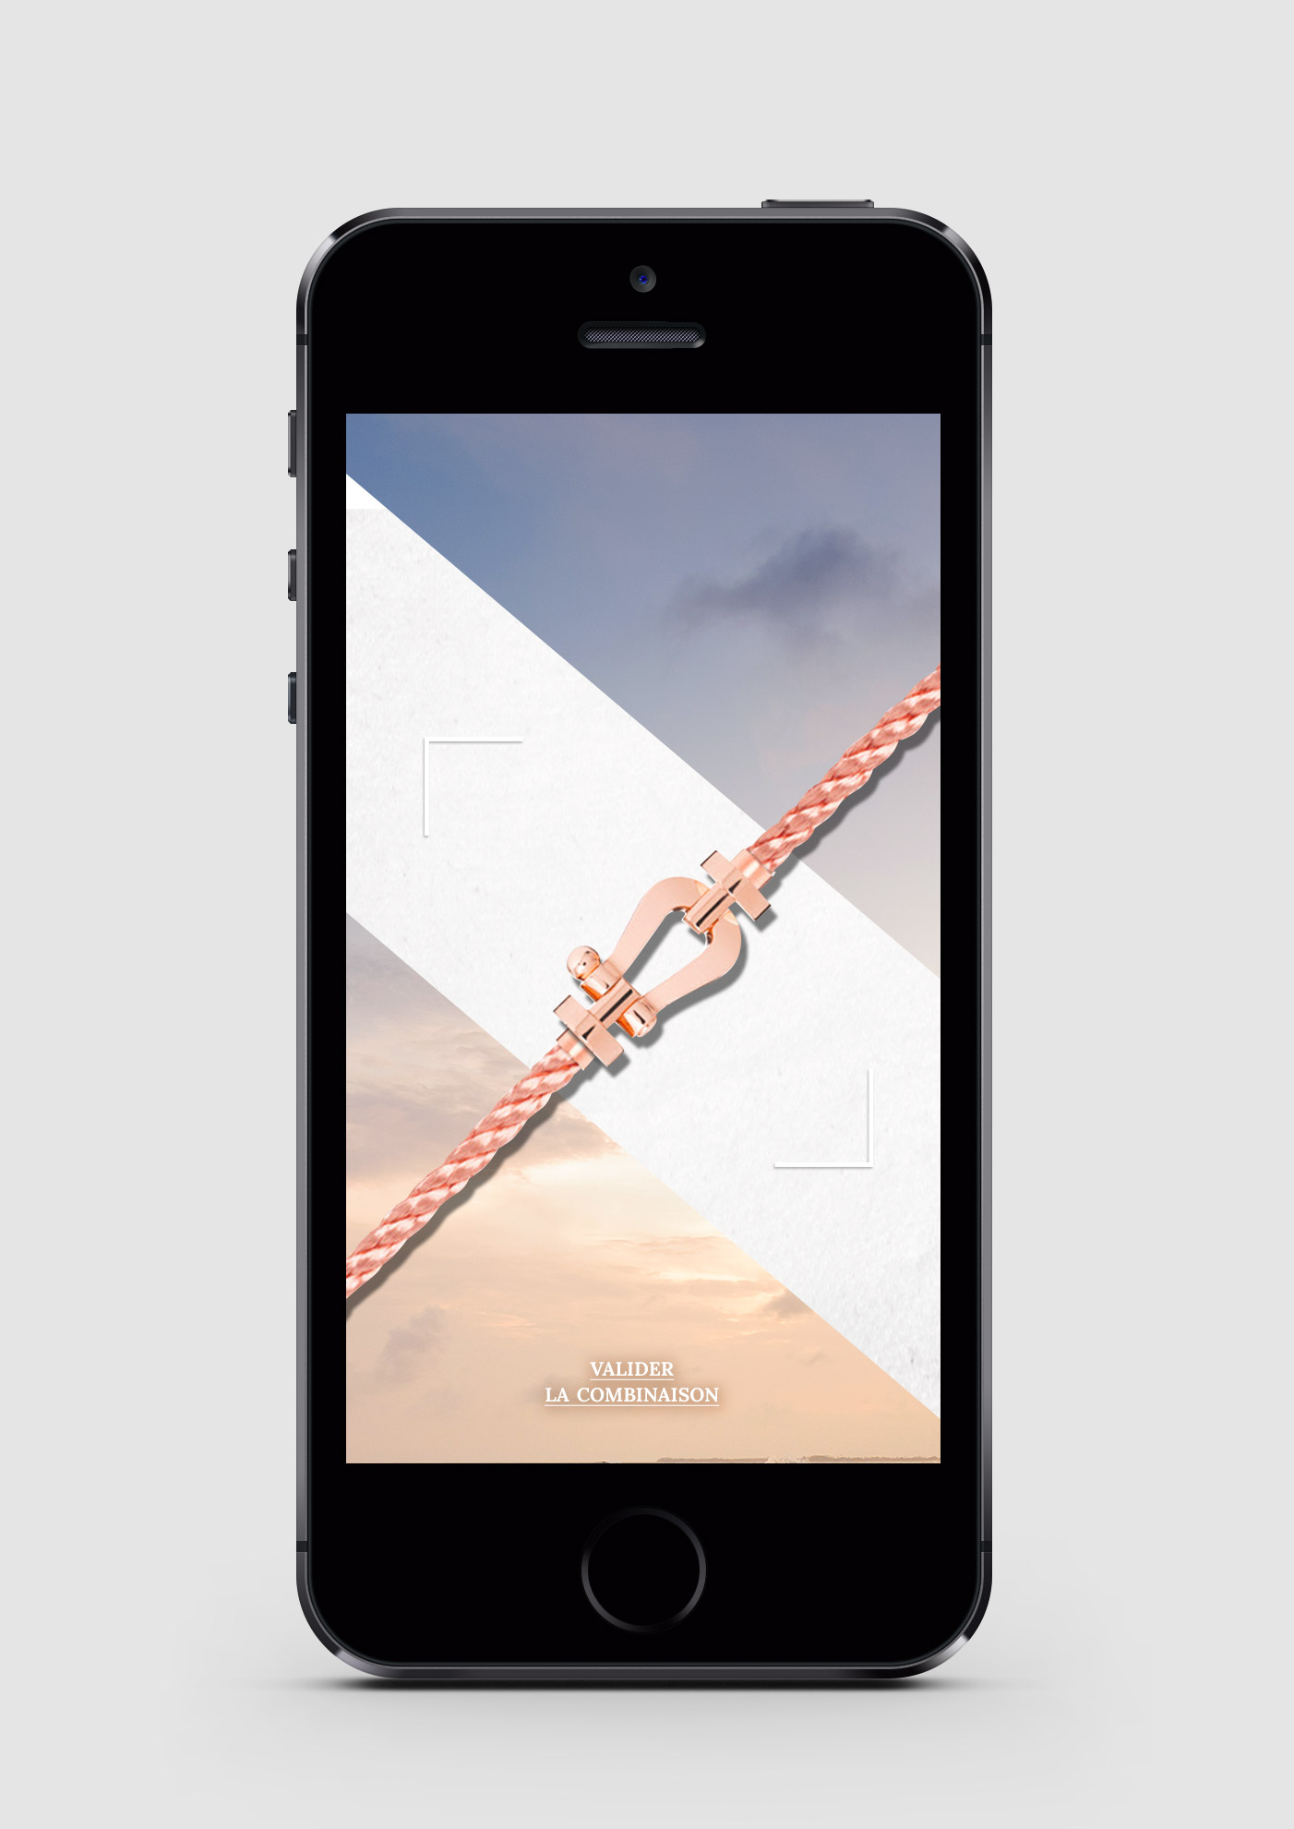
MECHANISM
8. We scroll shackles and cables to provide all possible combinations..
我们滚动各种卸扣和链条的组合，以创造各种可能的结合

Slide 14
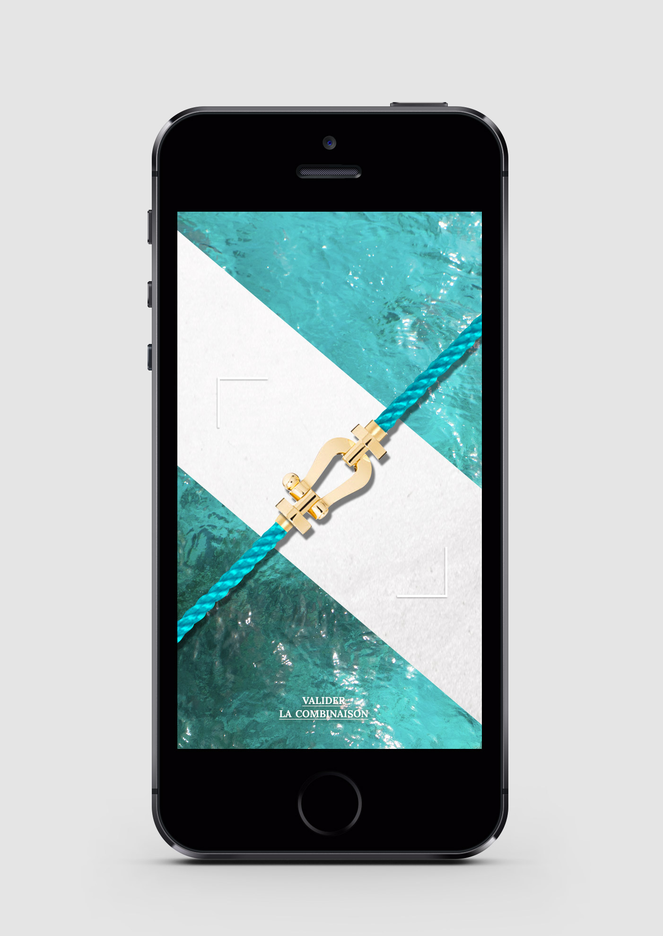
MECHANISM
9. We scroll shackles and cables to provide all possible combinations..
我们滚动各种卸扣和链条的组合，以创造各种可能的结合

Slide 15
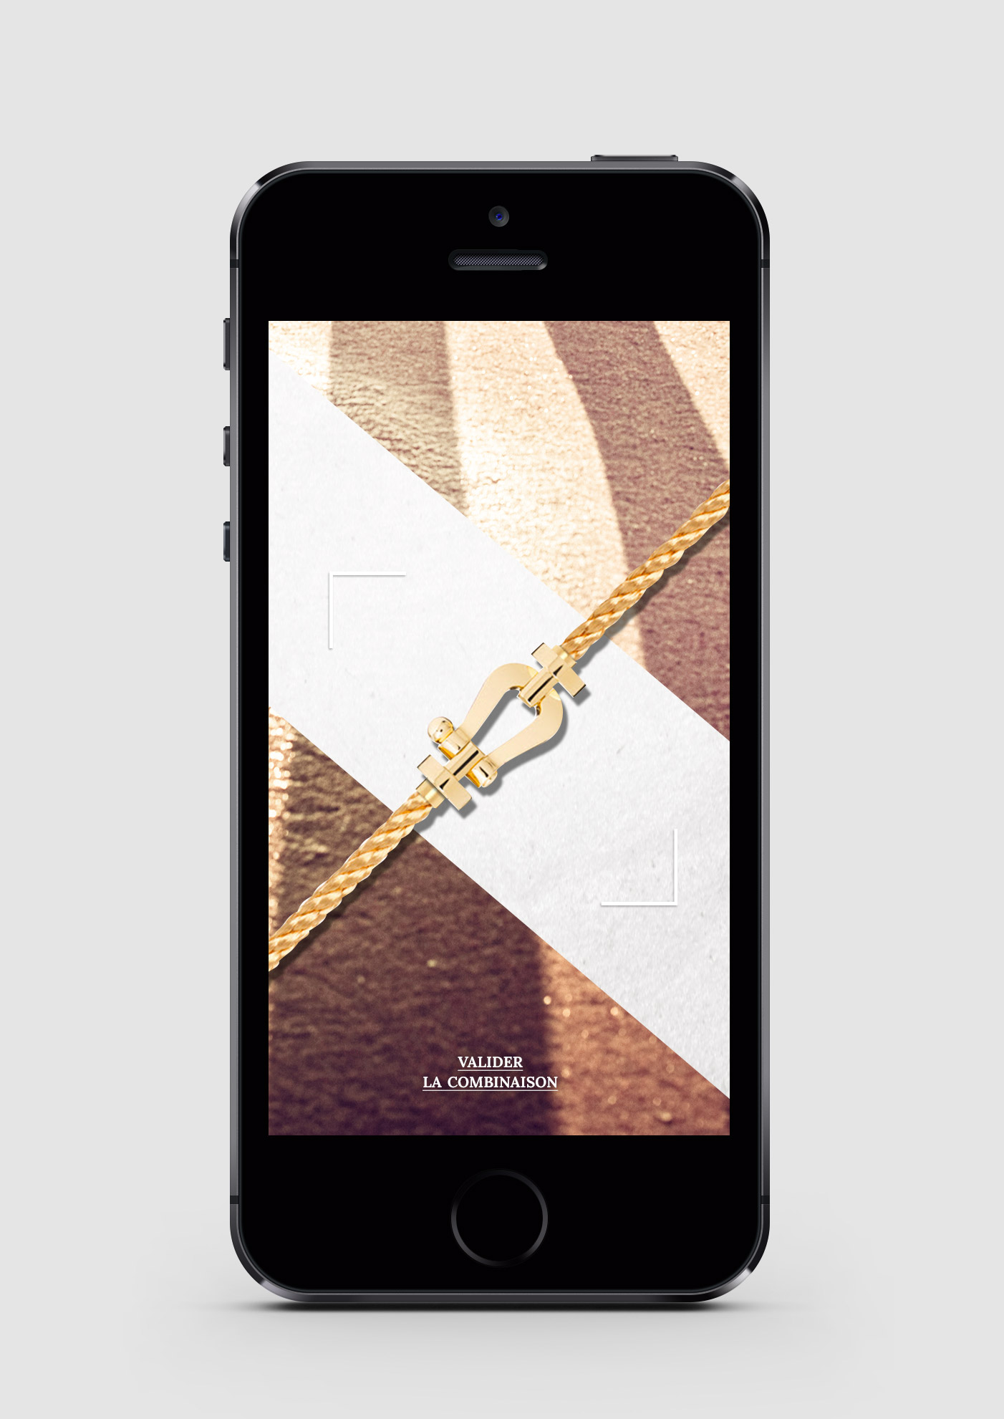
MECHANISM
10. We scroll shackles and cables to provide all possible combinations..
我们滚动各种卸扣和链条的组合，以创造各种可能的结合

Slide 16
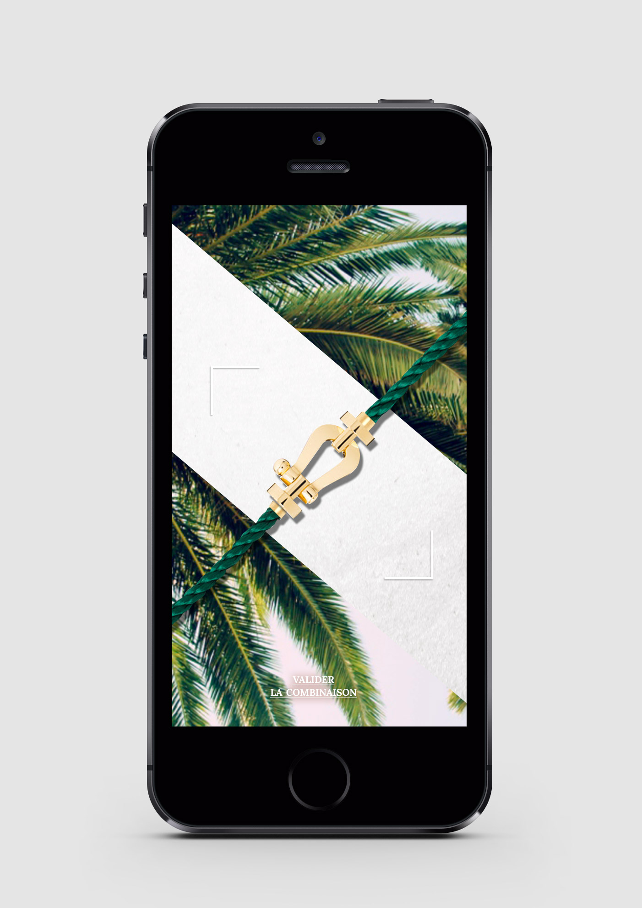
MECHANISM
11. We scroll shackles and cables to provide all possible combinations..
我们滚动各种卸扣和链条的组合，以创造各种可能的结合

Slide 17
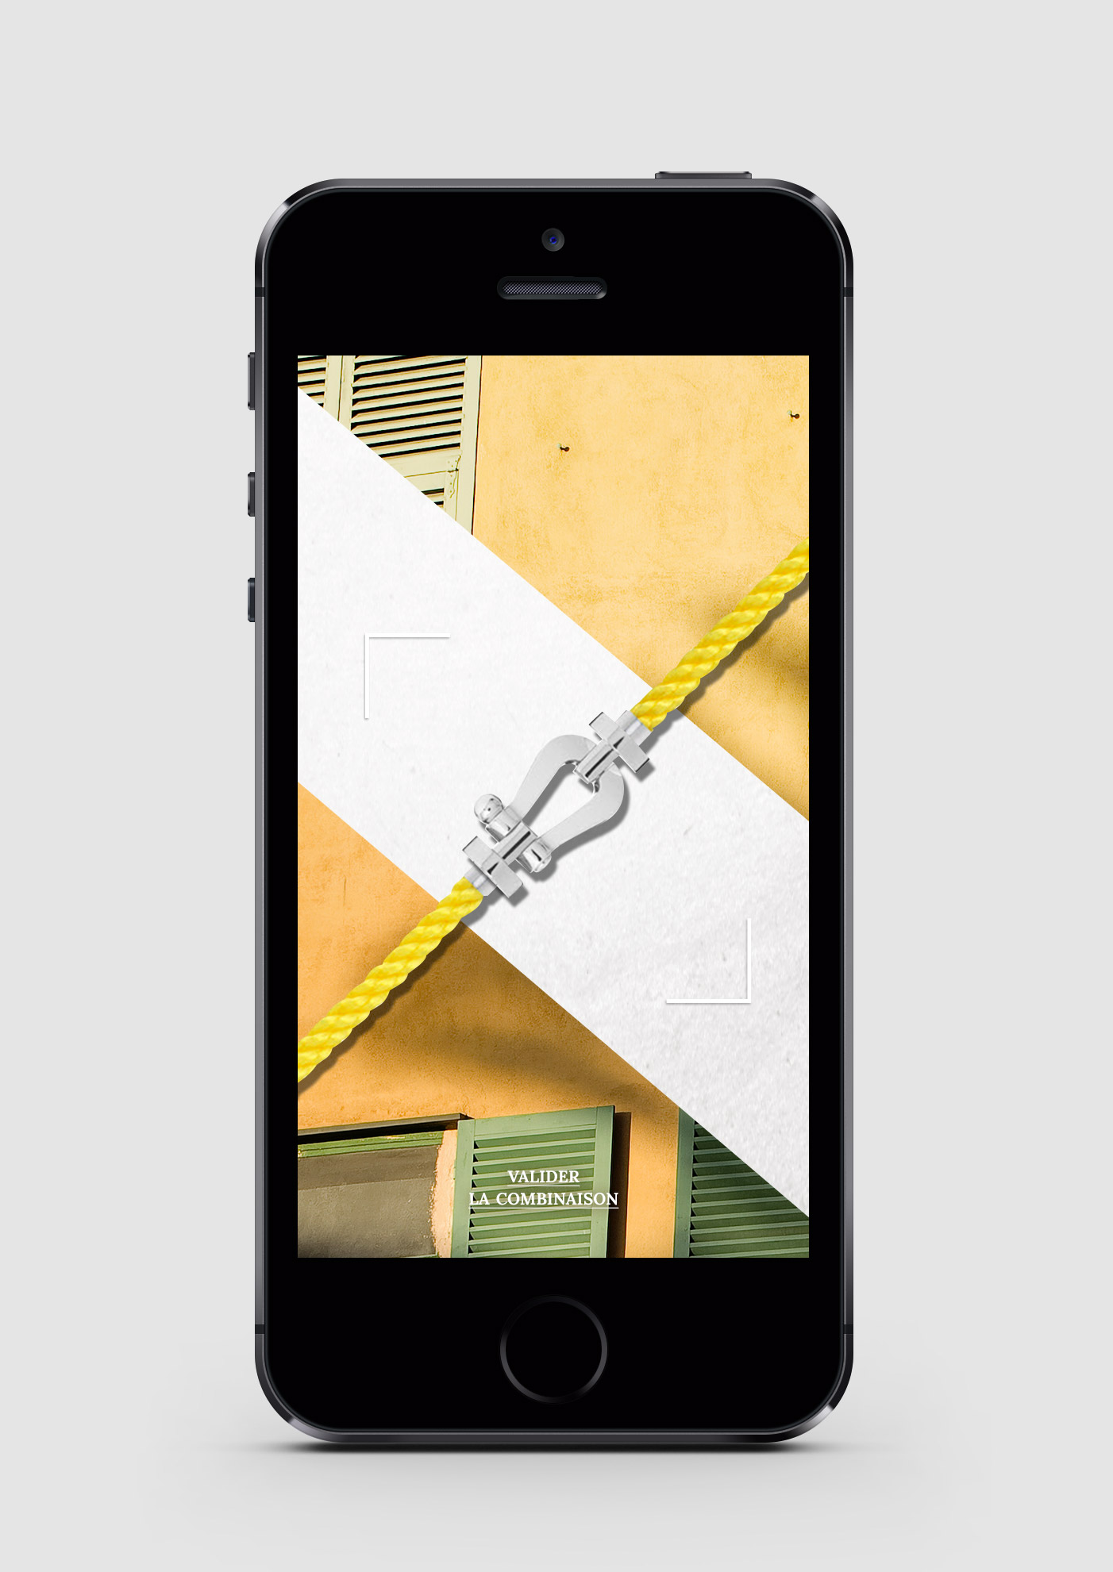
MECHANISM
12. We scroll shackles and cables to provide all possible combinations..
我们滚动各种卸扣和链条的组合，以创造各种可能的结合

Slide 18
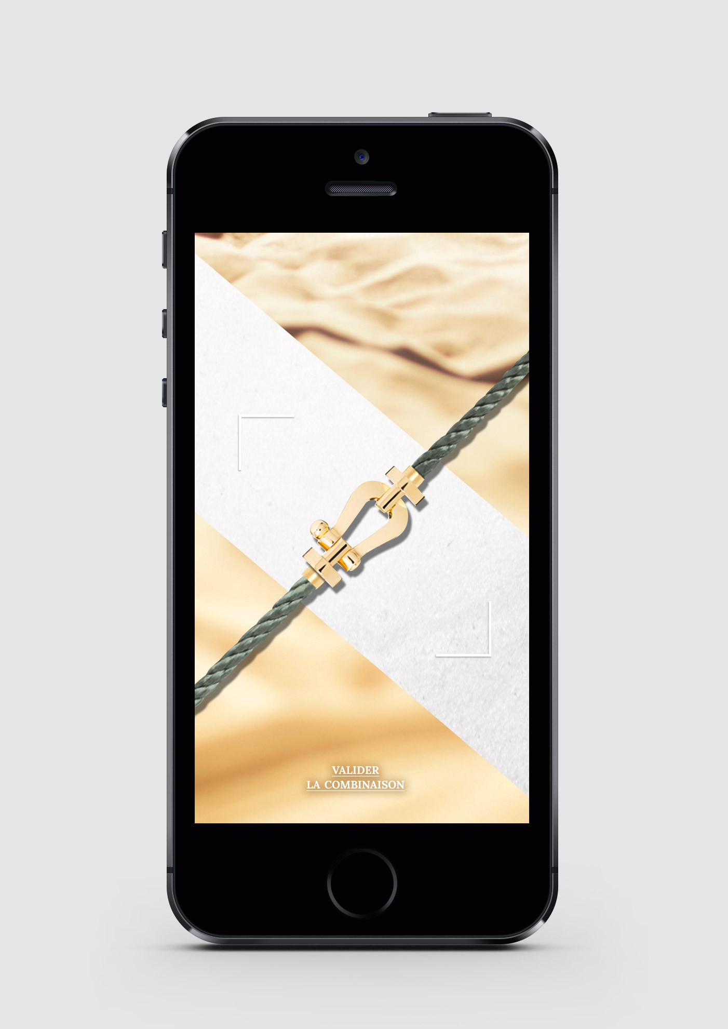
MECHANISM
13. We scroll shackles and cables to provide all possible combinations..
我们滚动各种卸扣和链条的组合，以创造各种可能的结合

Slide 19
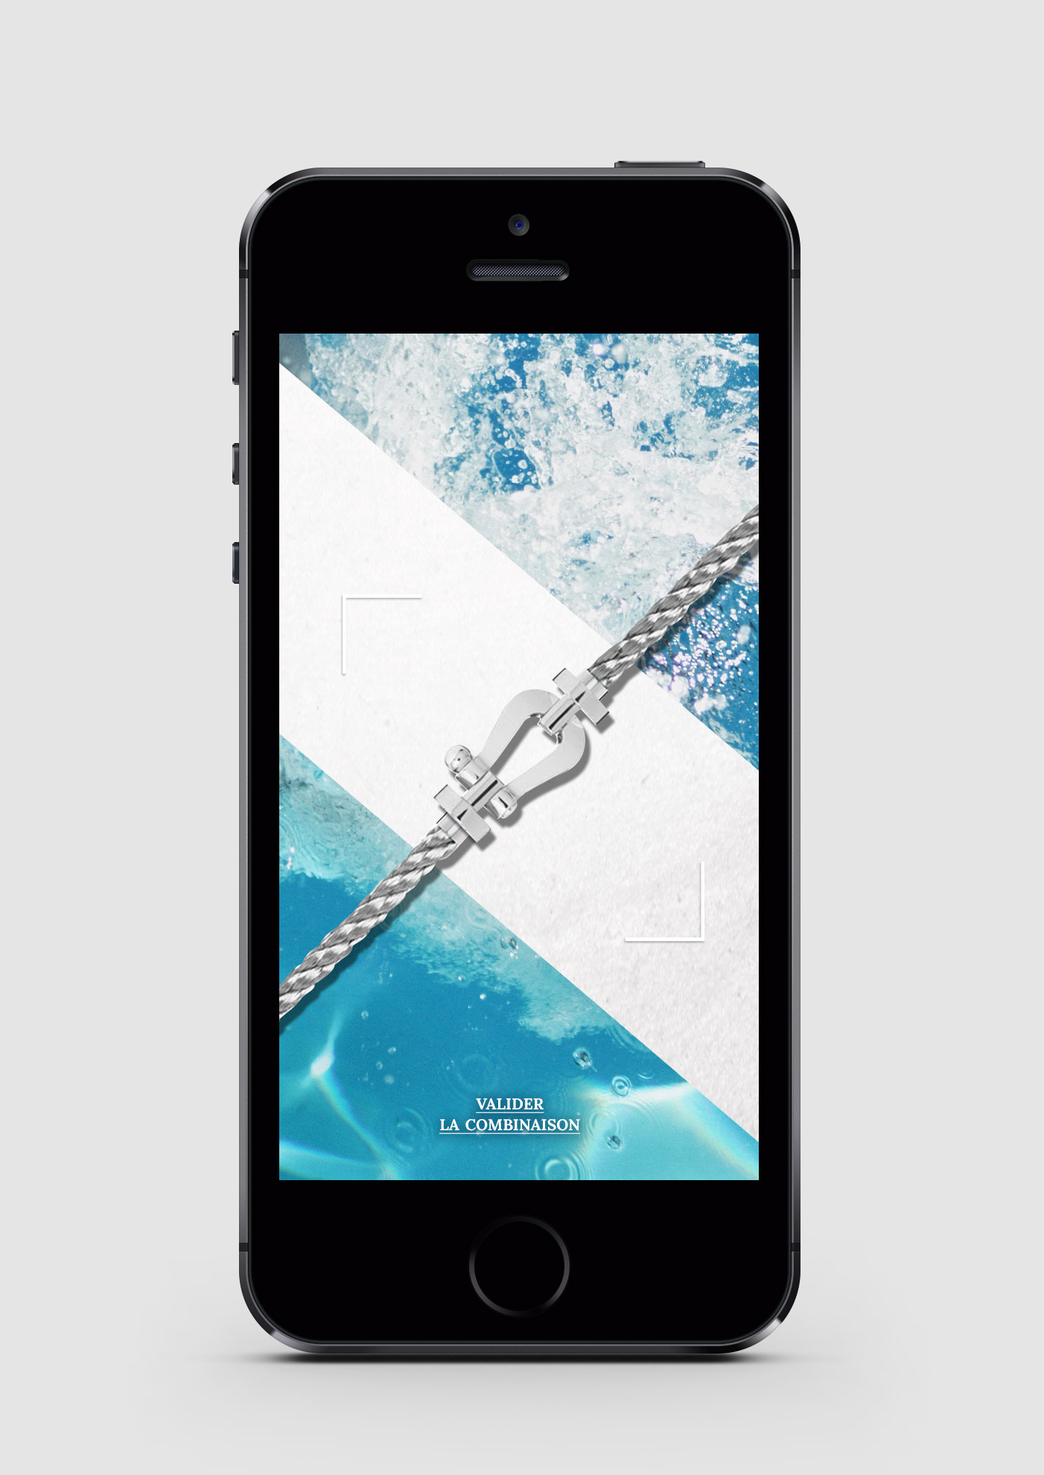
MECHANISM
14. We scroll shackles and cables to provide all possible combinations..
我们滚动各种卸扣和链条的组合，以创造各种可能的结合

Slide 20
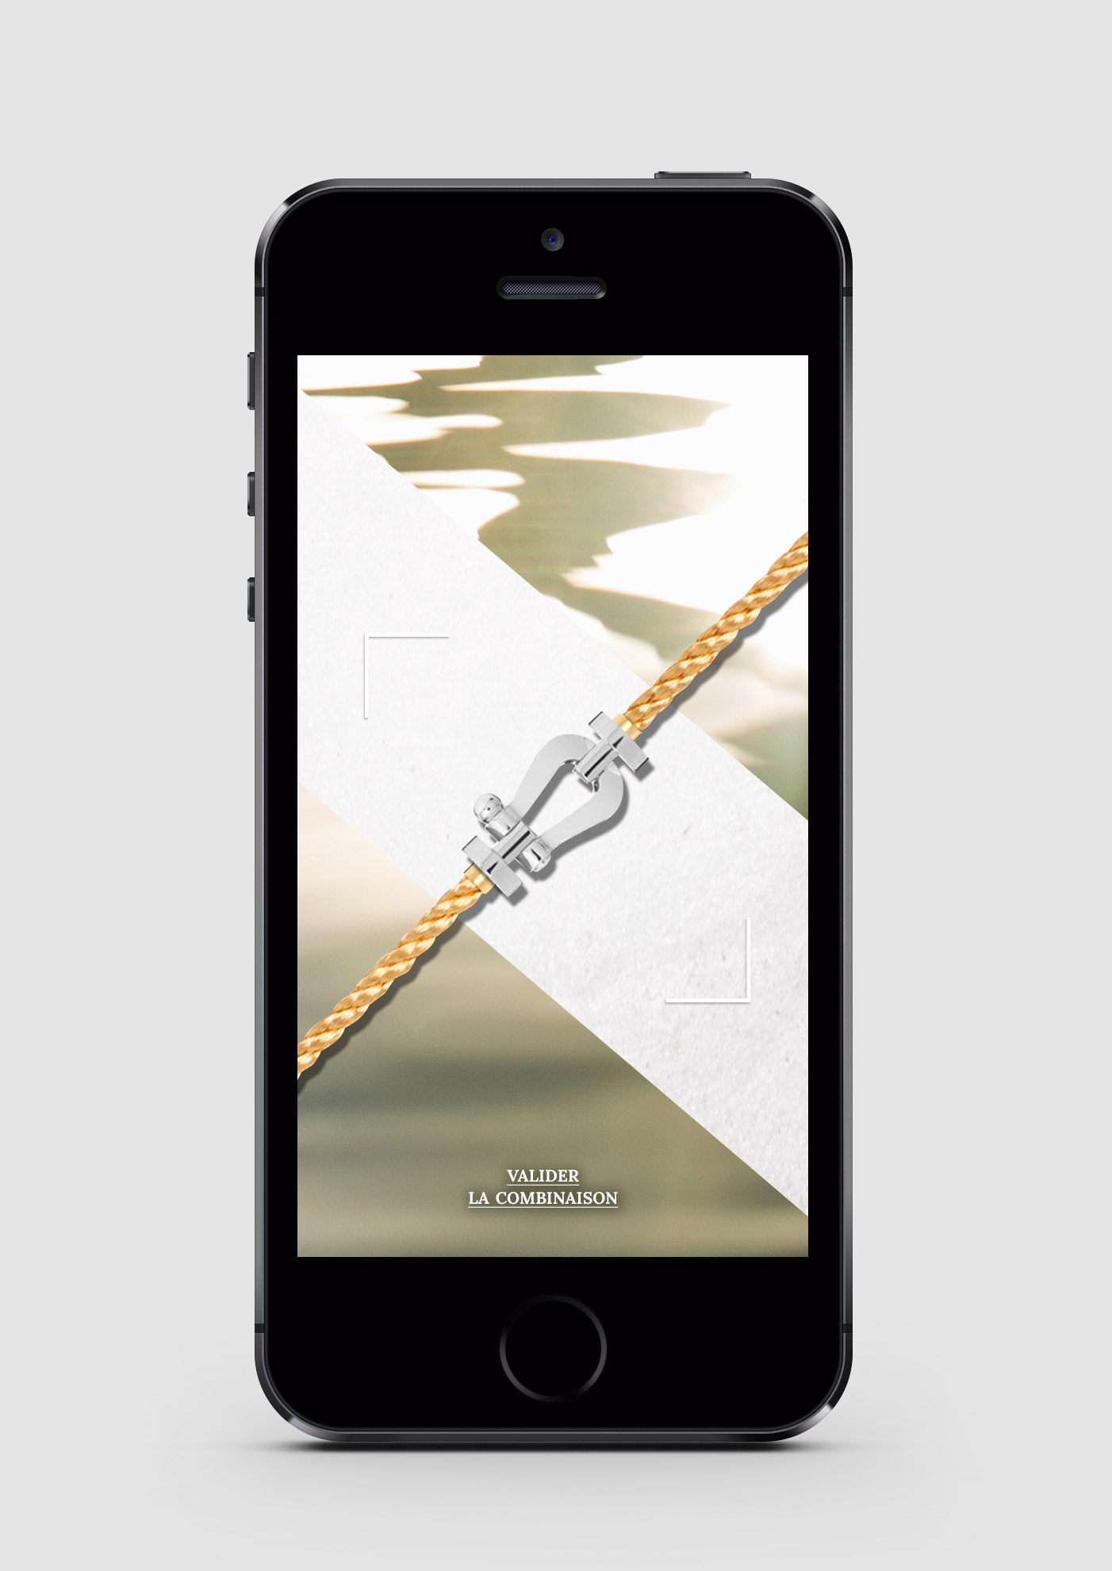
MECHANISM
15. .. Until the ideal combination that we wish to bring.
直到找到我们希望佩戴的最理想的组合
We validate our creation.
确认您创造的选择

Slide 21
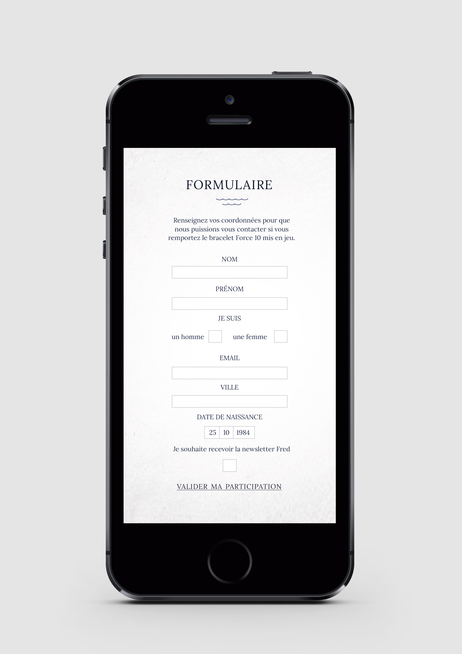
MECHANISM
16. To confirm your participation in the draw to win a personalized bracelet, we need to fill the form with the following:
为了获得抽签机会赢得手链，我们需要填下下述的表格 :
- Last name 姓
- First name 名
- Gender 性别
- E-mail 邮箱
- City 城市
- Birth date 出生日期
- Newsletter 选项
We validate our participation.确认参与活动

Slide 22
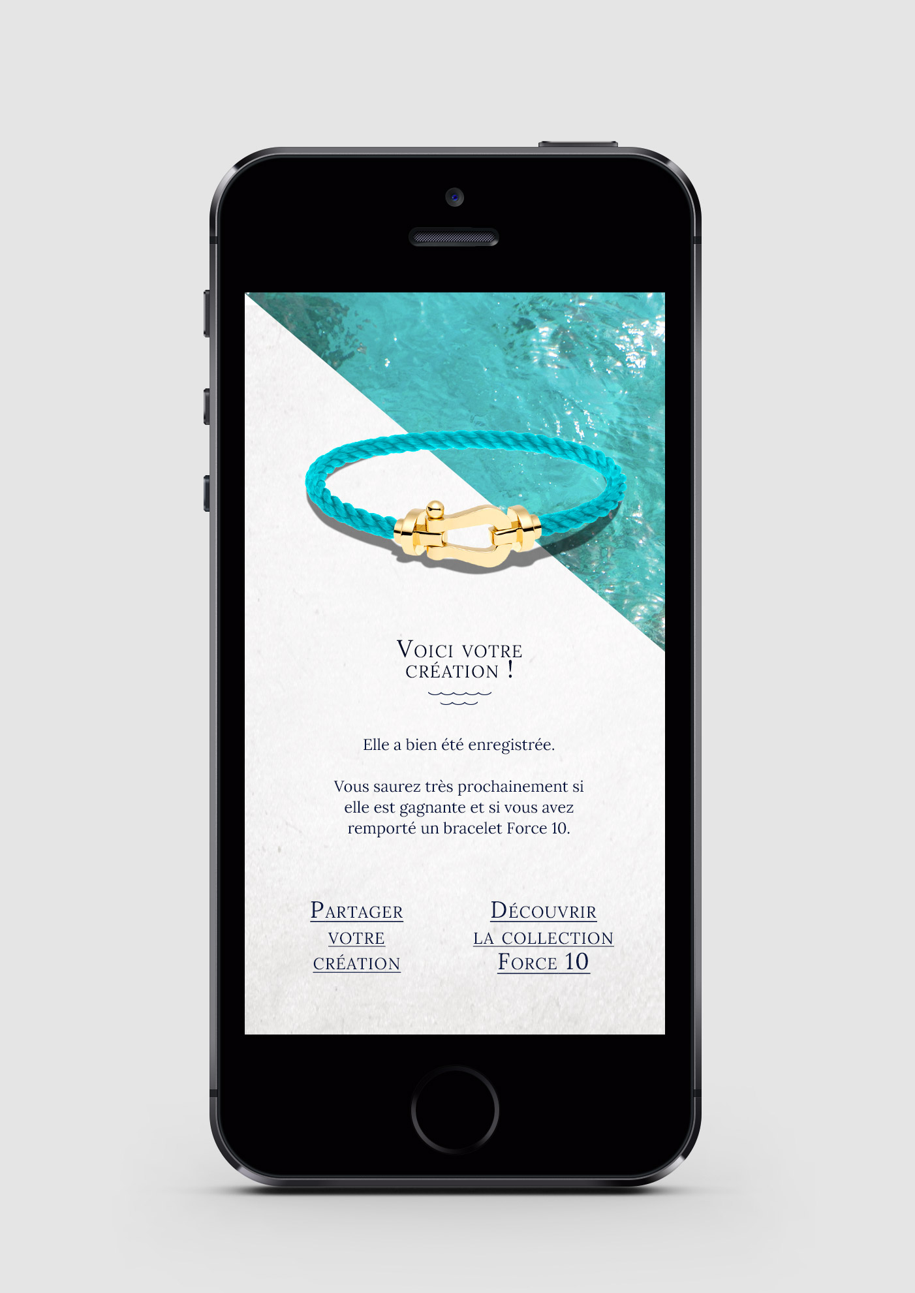
MECHANISM
17. Our creation appears and tells us that we may have the chance to be the winner and wear it soon to our wrist!
创造作品出现，并告知将有机会获得手链，可以戴在我们的手腕上
This page gives us the opportunity to share our creation and discover the entire collection "FORCE 10.
这一页面可以分享我们的创作并看到FORCE 10的全部集合

Slide 23
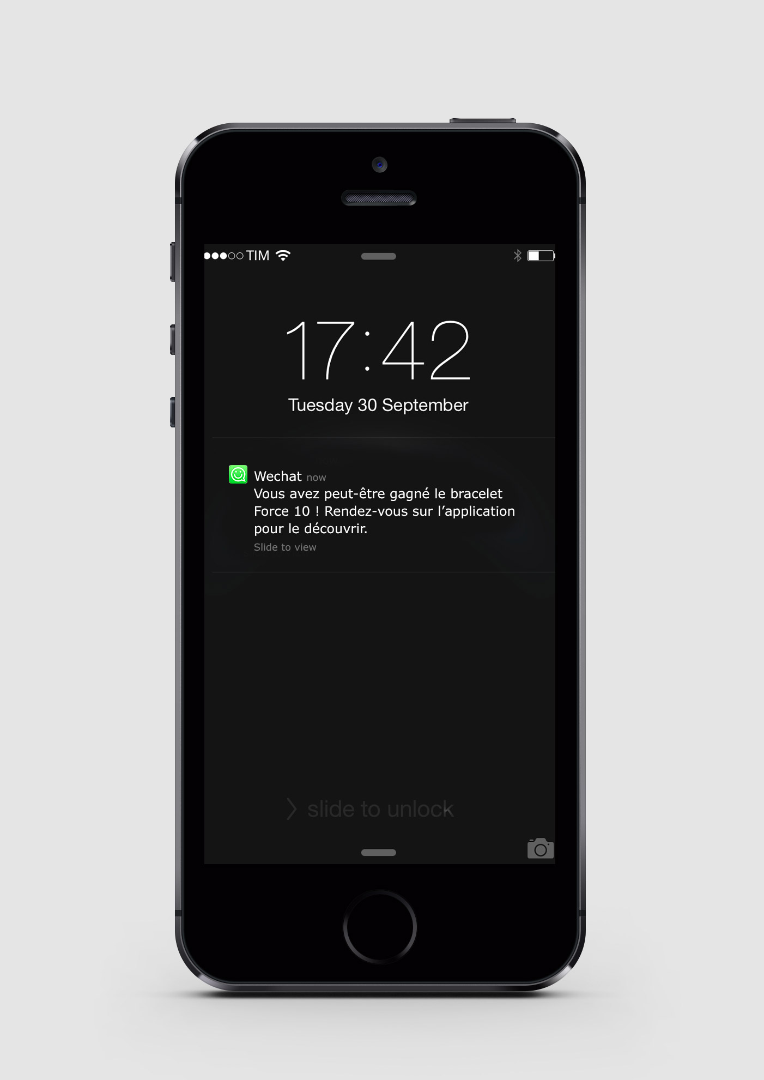
MECHANISM
18. At the end of the game week, we receive a notification on our WeChat account.
Clicking our result is displayed ...
在活动结束后，我们将在微信账户收到一个确认信息，点击显示结果…..
China alternative: results can be announced via text message service, or wechat article push.
中国区也可以用短信或者微信文章宣布获奖结果。

Slide 24

MECHANISM
19. We can win the crafted bracelet and thus be invited to get it in the store.
我们可以赢得精心制作的手链并获邀进入门店

Slide 25
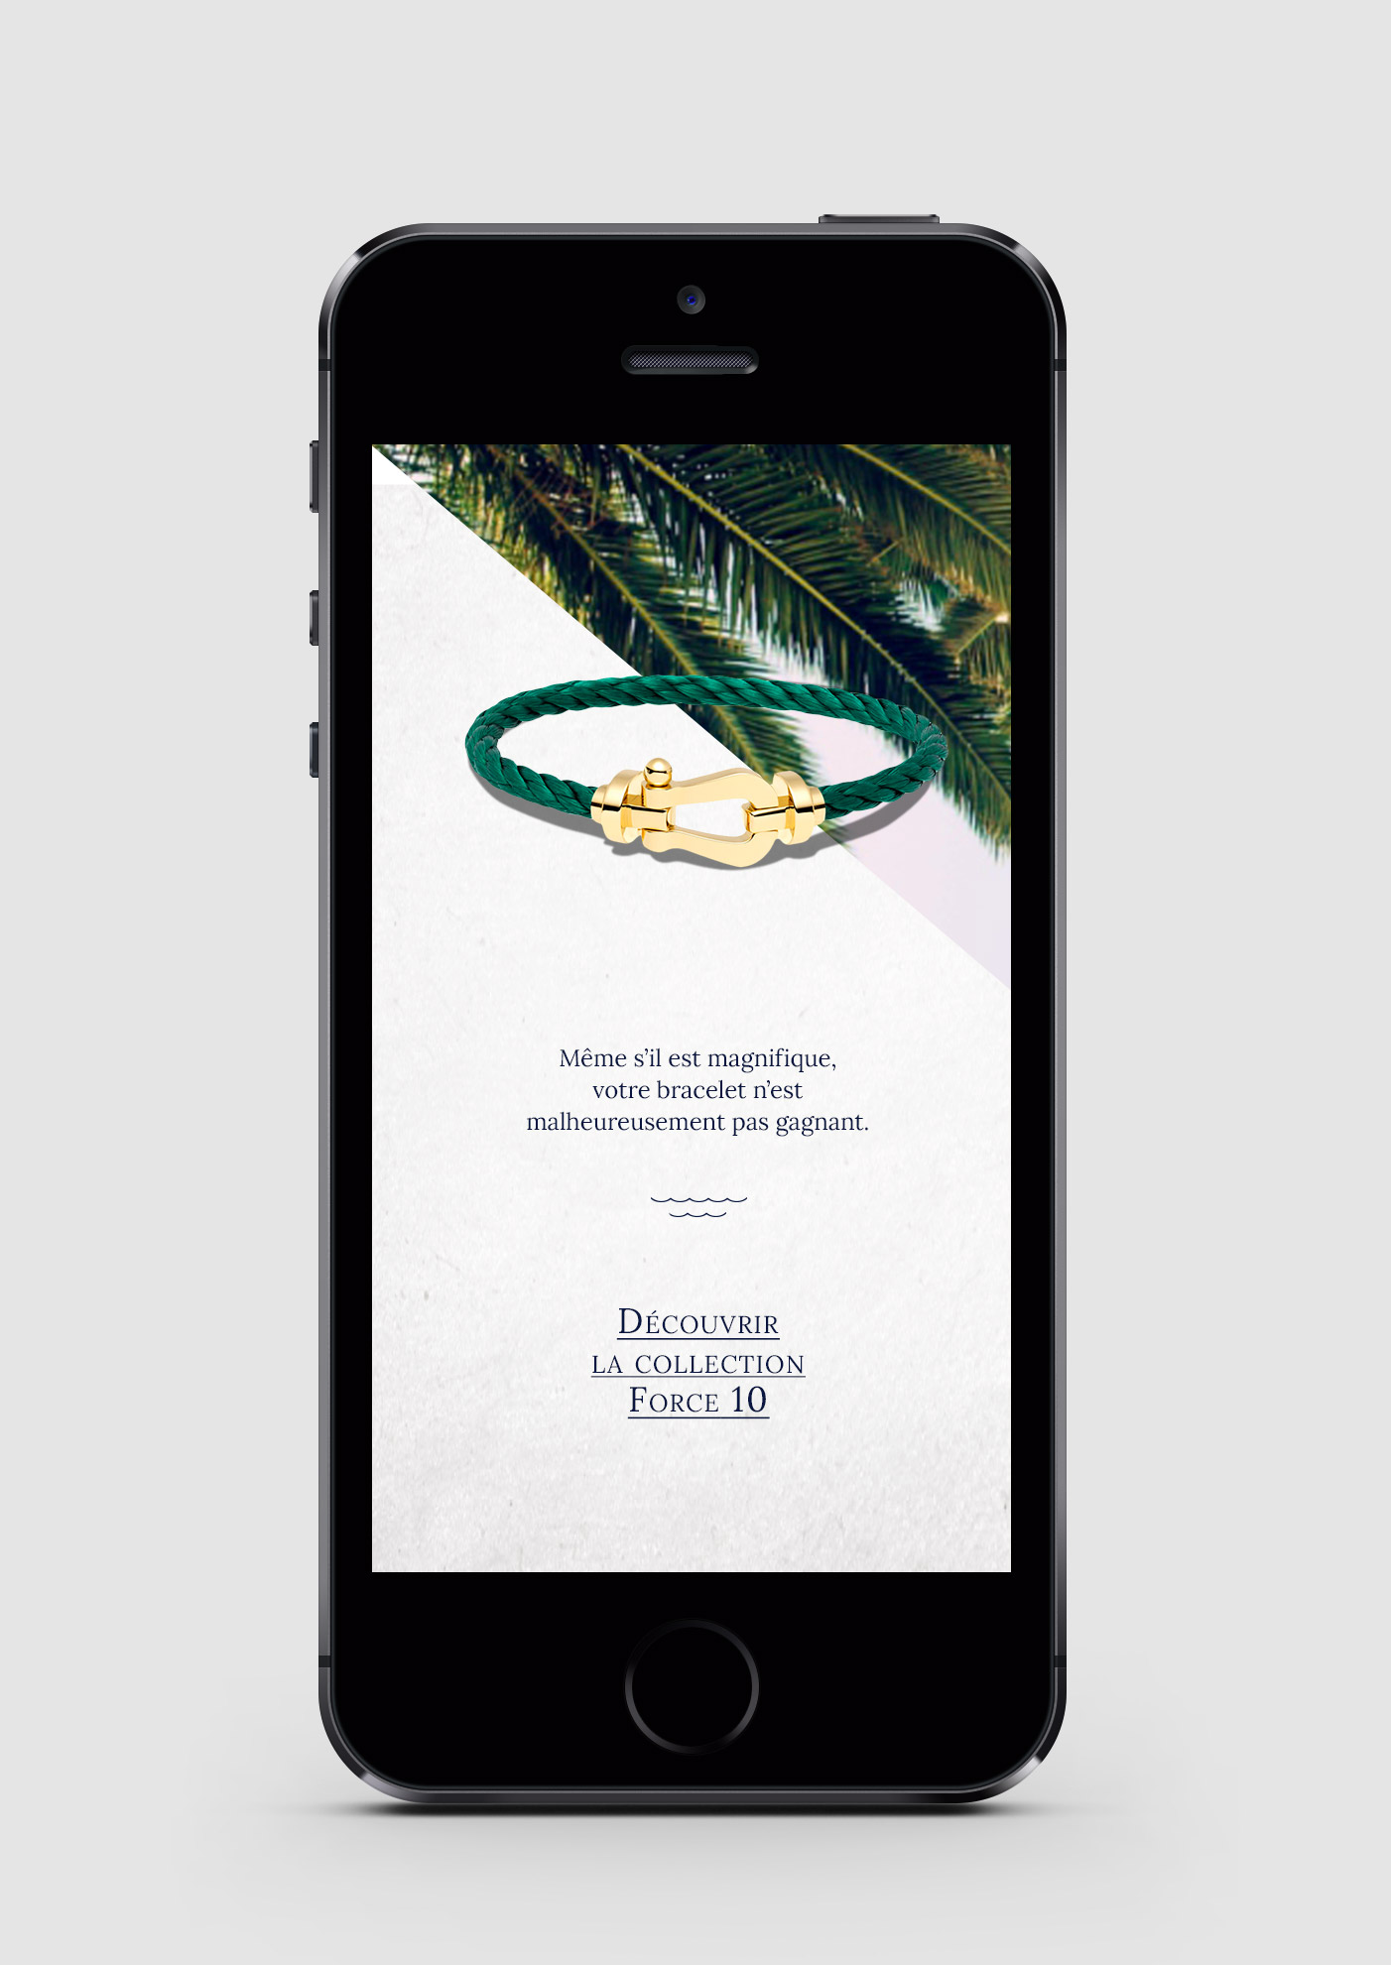
MECHANISM
20. Or not to be the biggest winner. 或者没有成为最大的赢家
We will be invited to discover the collection FORCE 10.
我们将被邀请发现 Force10 的集合

Slide 26
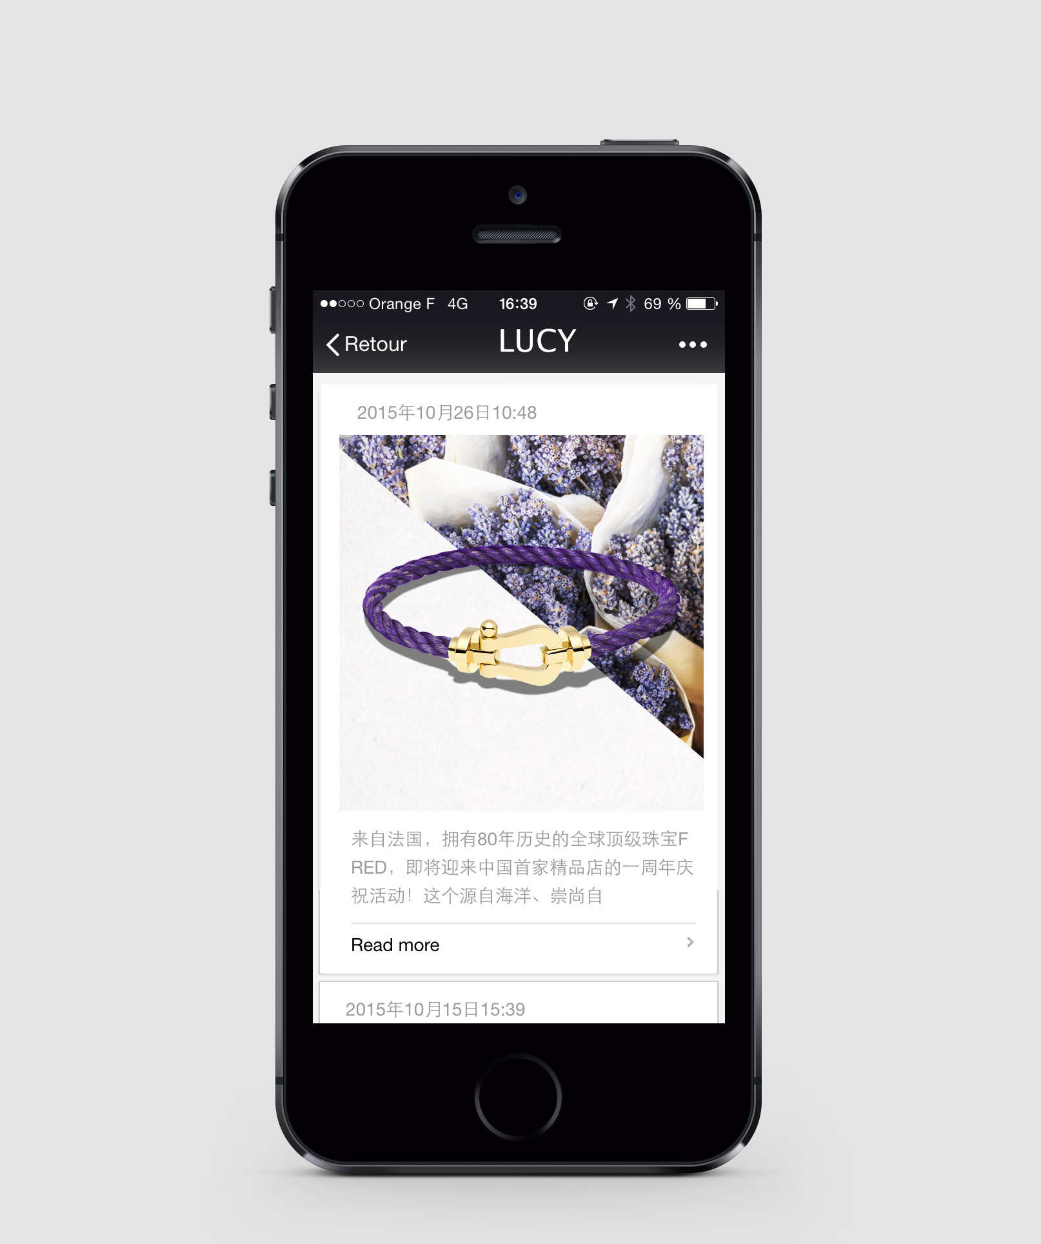
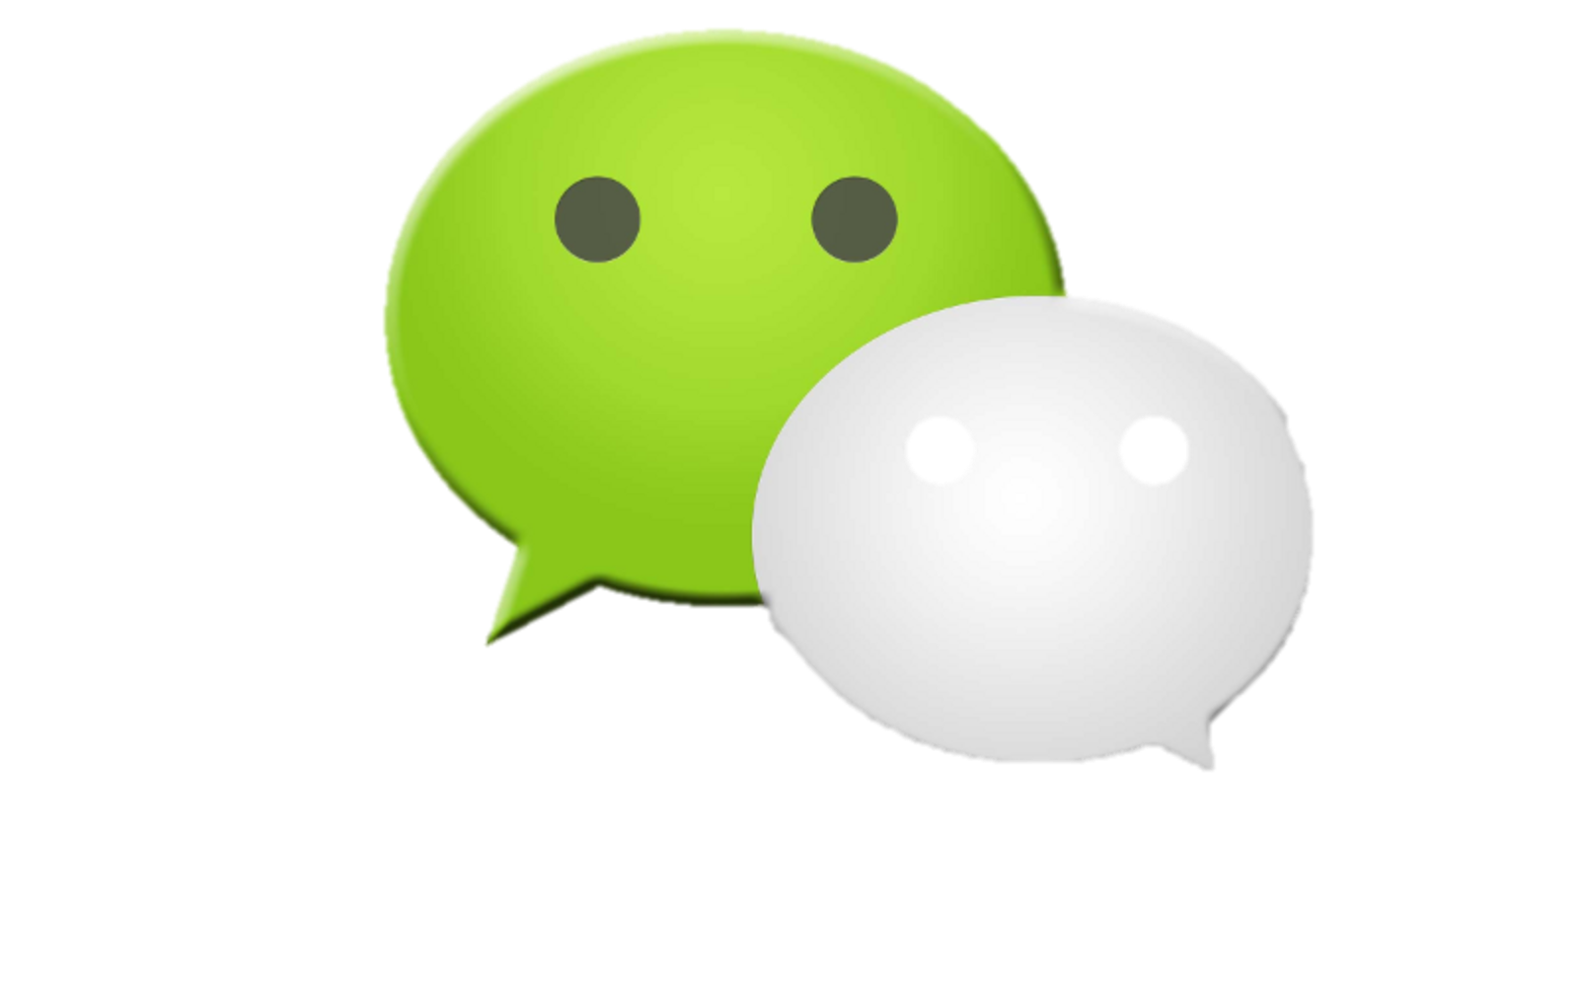
COMMUNICATION
We would like that some KOL create their ideal combination and share their creation.
我们希望部分KOL可以创作他们自己的理想组合并分享他们的成果
This would emphasize to participate.
这样可以让用户持续参与这一活动

Slide 27
MERCI

